Slide 1
Statistics for AI&DS
By Naufil Kazi

Slide 2
Course Overview
Prerequisite: C Programming
Prerequisite: Discrete Structures and Graph Theory
Course Objectives: The course aims
To Perform exploratory analysis on the datasets
To Understand the various distribution and sampling
To Perform Hypothesis Testing on datasets
To Explore different techniques for Summarizing Data
To Perform The Analysis of Variance
To Explore Linear Least Squares
Course Outcomes: Learner will be able to
Illustrate Exploratory Data Analysis
Describe Data and Sampling Distributions
Solve Statistical Experiments and Significance Testing
Demonstrate Summarizing Data
Interpret the Analysis of Variance
Use Linear Least Squares

Slide 3
Modules
Exploratory Data Analysis
Data and Sampling Distribution
Statistical Experiments and Significance Testing
Summarizing Data
The Analysis of Variance
Linear Least Squares

Slide 4
Assessment
Internal Assessment: Assessment: Assessment consists of two class tests of 20 marks each. The first-class test is to be conducted when approx. 40% syllabus is completed and second class test when additional 40% syllabus is completed. Duration of each test shall be one hour.
End Semester Theory Examination:
1 Question paper will consist of 6 questions, each carrying 20 marks.
2 The students need to solve a total of 4 questions.
3 Question No.1 will be compulsory and based on the entire syllabus.
4 Remaining question (Q.2 to Q.6) will be selected from all the modules.

Slide 5
Introduction to Structured Data
Structured Data refers to data that is organized in a predefined manner, often in tabular format with rows and columns. It is typically stored in databases and is easily searchable by algorithms.

Slide 6
Introduction to Structured Data
Semi-Structured data
Semi-structured data is information that does not reside in a relational database but that has some organizational properties that make it easier to analyze. With some processes, you can store them in the relation database (it could be very hard for some kind of semi-structured data), but Semi-structured exist to ease space. Example: XML data.
Unstructured data
Unstructured data is a data which is not organized in a predefined manner or does not have a predefined data model, thus it is not a good fit for a mainstream relational database. So for Unstructured data, there are alternative platforms for storing and managing, it is increasingly prevalent in IT systems and is used by organizations in a variety of business intelligence and analytics applications. Example: Word, PDF, Text, Media logs.

Slide 7
Elements of Structured Data
Data Types
Numerical Data: Quantitative data that can be measured and assigned a number. Examples include integers, floats, and doubles.
Categorical Data: Qualitative data that represents categories or groups. Examples include strings and enums.
Date and Time: Data types that represent dates and times. Examples include timestamps, dates, and intervals.

Slide 8
Elements of Structured Data
Attributes (Columns)
Attribute Names: The names given to columns in a dataset.
Attribute Values: The actual data points stored under each column.
Records (Rows)
Record ID: A unique identifier for each row in a dataset.
Record Values: The actual data points stored in each row.
Metadata
Schema: Defines the structure of the data, including the data types and constraints for each column.
Indexes: Structures that improve the speed of data retrieval operations.

Slide 9
Rectangular Data
Rectangular Data refers to data organized in a table with rows and columns. Each column represents a variable, and each row represents a record.
Examples:
Spreadsheets: Excel, Google Sheets
Databases: SQL tables
Data Frames: Used in programming languages like R and Python (Pandas)
Characteristics:
Homogeneous Columns: Each column contains data of the same type.
Fixed Number of Columns: The number of columns is defined by the schema.
Variable Number of Rows: The number of rows can vary as records are added or removed.

Slide 10
Data Frames
Data Frames are two-dimensional, size-mutable, and potentially heterogeneous tabular data structures with labeled axes (rows and columns). They are widely used in data manipulation and analysis.
Key Features:
Labeled Axes: Both rows and columns are labeled.
Heterogeneous Data: Columns can contain different types of data (numerical, categorical, etc.).
Size-Mutable: Rows and columns can be added or removed.
Common Operations:
Indexing: Accessing specific rows or columns using labels or positions.
Filtering: Subsetting the data based on conditions.
Aggregation: Summarizing data using functions like sum, mean, count, etc.
Merging: Combining multiple data frames.

Slide 11
Indexes
Indexes are data structures that improve the speed of data retrieval operations on a data frame or database table. They allow quick lookup of rows based on column values.
Types of Indexes:
Primary Index: Unique identifier for each row (e.g., primary key in SQL).
Secondary Index: Additional indexes on other columns to speed up queries.
Benefits:
Faster Query Performance: Significantly reduces the time to retrieve data.
Efficient Sorting and Filtering: Allows quick sorting and filtering of data.
Drawbacks:
Storage Overhead: Indexes require additional storage space.
Update Overhead: Maintaining indexes can slow down insert, update, and delete operations.

Slide 12
Nonrectangular Data Structures
Nonrectangular Data Structures are data structures that do not fit neatly into a table with rows and columns. They are often used to represent more complex relationships and data formats.
Examples:
Hierarchical Data: Data organized in a tree-like structure (e.g., XML, JSON).
Graph Data: Data representing nodes and edges (e.g., social networks, road maps).
Sparse Matrices: Matrices with a large number of zero elements (e.g., term-document matrices).

Slide 13
Assignment
Find a dataset online (e.g., from Kaggle) and load it into a data frame. Identify and describe the structure of the data (columns, data types, missing values, etc.).

Slide 14
Measures of Central Tendency
Measures of central tendency are statistical metrics that describe the center or typical value of a dataset. The most common measures are the mean and median, which summarize data with a single representative value. These measures are crucial for understanding the general behavior of data.

Slide 15
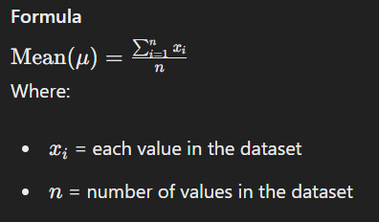
Mean
The mean (or average) is the sum of all values in a dataset divided by the number of values. It is one of the most common measures of central tendency.

Slide 16
Median
The median is the middle value of a dataset when it is ordered from smallest to largest. If the dataset has an even number of values, the median is the average of the two middle values.
Finding the Median
Order the data from smallest to largest.
Identify the middle value.
For an odd number of values: The median is the middle value.
For an even number of values: The median is the average of the two middle values.

Slide 17
Mode
The mode is the value that appears most frequently in a data set. A data set can have more than one mode if multiple values occur with the same highest frequency, and if no value repeats, the data set has no mode.

Slide 18
Comparison
Mean: Best used for data sets without outliers. Provides a general idea of the data set but can be skewed by extreme values.
Median: Best used for skewed data sets or those with outliers. Gives a better representation of the data set's central tendency when outliers are present.
Mode: Best used for categorical data or to identify the most common value. Provides insight into the frequency of specific values.

Slide 19
Robust Estimates
Robust estimates are statistical measures that are resistant to outliers and provide a more reliable central tendency for skewed or non-normal distributions. Common robust estimates include the trimmed mean and the median absolute deviation (MAD).

Slide 20
Trimmed Mean
The trimmed mean is calculated by removing a specified percentage of the smallest and largest values from the dataset before computing the mean. This reduces the influence of outliers.
Example
For the dataset: 1, 3, 5, 7, 9, 100
With 20% trimming, remove 1 and 100.
Remaining values: 3, 5, 7, 9
Trimmed Mean=6

Slide 21
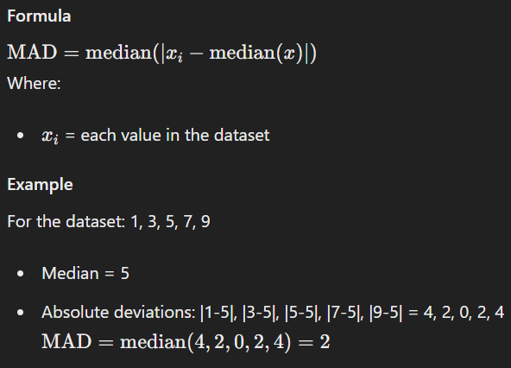
Median Absolute Deviation (MAD)
MAD measures the variability of a dataset by calculating the median of the absolute deviations from the dataset's median. It is a robust measure of variability.

Slide 22
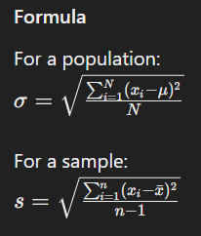
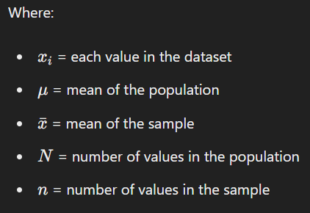
Standard Deviation
Standard Deviation (SD) measures the average distance of each data point from the mean. It quantifies the amount of variation or dispersion in a dataset.

Slide 23
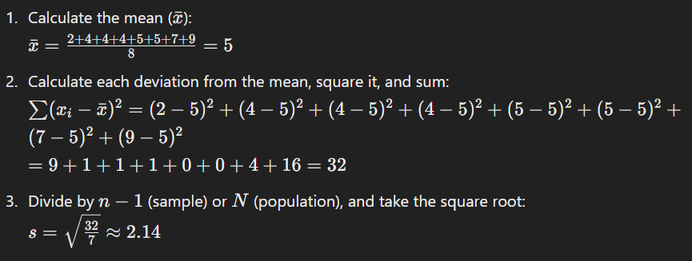
Example
For the dataset: 2, 4, 4, 4, 5, 5, 7, 9

Slide 24
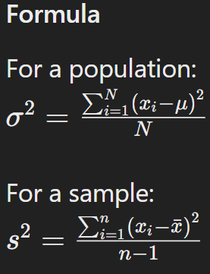
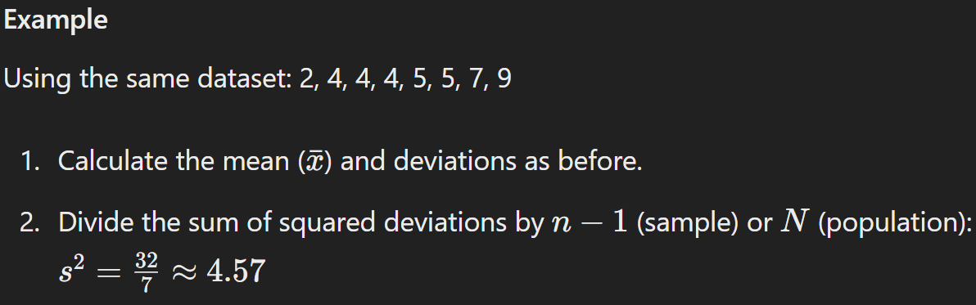
Variance
Variance is the average of the squared deviations from the mean. It provides a measure of how much the data points differ from the mean.

Slide 25
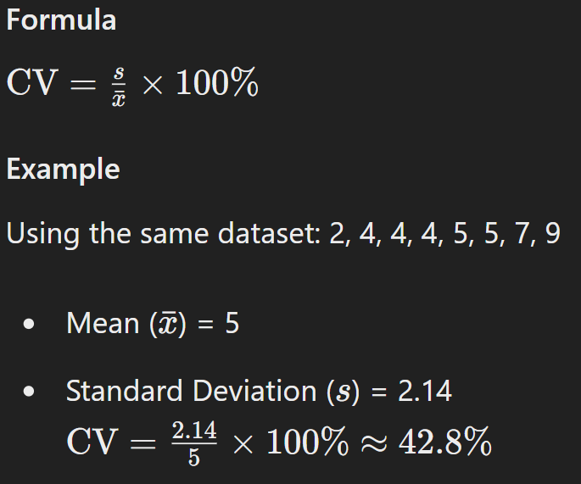
Coefficient of Variation (CV)
Coefficient of Variation (CV) is the ratio of the standard deviation to the mean, expressed as a percentage. It measures relative variability.

Slide 26
Percentiles
Percentiles are measures that divide a dataset into 100 equal parts. Each percentile represents the value below which a given percentage of observations in a dataset fall. Percentiles are used to understand the distribution of data and identify outliers.

Slide 27
Percentiles
Percentile Rank (p): A value below which a given percentage of observations fall. For example, the 25th percentile is the value below which 25% of the observations may be found.
Quartiles: Special types of percentiles that divide the data into four equal parts:
Q1 (First Quartile): 25th percentile
Q2 (Second Quartile, Median): 50th percentile
Q3 (Third Quartile): 75th percentile
Interquartile Range (IQR): The range between the first quartile (Q1) and the third quartile (Q3).
IQR=Q3−Q1

Slide 28
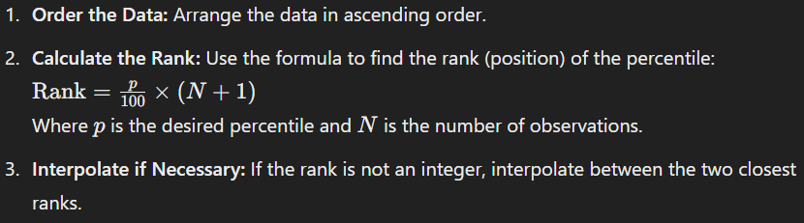
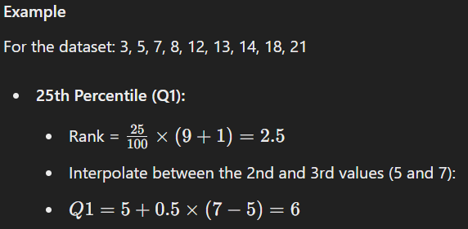
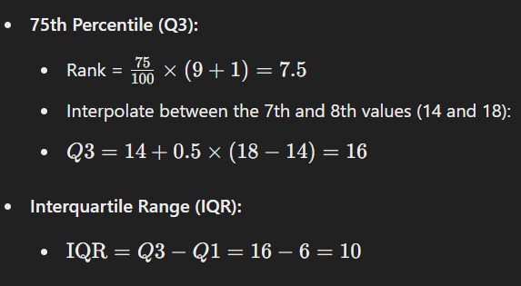
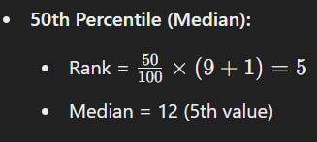
Calculating Percentiles

Slide 29
Assignment
Calculate the mean, median, and standard deviation for numerical columns in your dataset. Compare the results and discuss any outliers or interesting findings.

Slide 30
Boxplots
Boxplots (or box-and-whisker plots) are graphical representations of the distribution of a dataset that display the dataset’s five-number summary: minimum, first quartile (Q1), median (Q2), third quartile (Q3), and maximum.

Slide 31
Components of a Boxplot
Box: Represents the interquartile range (IQR), spanning from Q1 to Q3.
Median Line: A line inside the box representing the median (Q2).
Whiskers: Lines extending from the box to the smallest and largest values within 1.5 times the IQR from Q1 and Q3, respectively.
Outliers: Points outside the whiskers, indicating potential outliers.

Slide 32
Constructing a Boxplot
Calculate Q1(25th Percentile), Median (Q2), and Q3(75th Percentile)
Determine the IQR
Calculate the Whiskers
Lower whisker: Q1−1.5×IQR
Upper whisker: Q3+1.5×IQR
Identify Outliers
Data points beyond the whiskers.

Slide 33
Interpretation of Boxplots
Central Tendency: The median line inside the box shows the central value.
Spread: The length of the box (IQR) indicates the spread of the middle 50% of the data.
Symmetry: If the median is centered in the box and the whiskers are roughly equal, the data is symmetrically distributed.
Skewness: If the median is closer to Q1 or Q3, or if one whisker is longer, the data is skewed.
Outliers: Points outside the whiskers suggest outliers that may need further investigation.

Slide 34
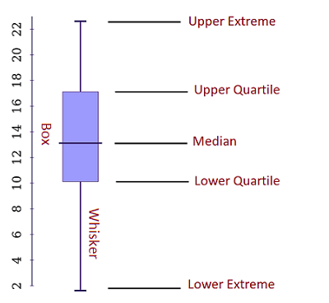
Example of Boxplot

Slide 35
Example 1
Suppose you have the math test results for a class of 15 students. Here are the results:
91 95 54 69 80 85 88 73 71 70 66 90 86 84 73

Slide 36
Example 1
Step 1: Order the data points from least to greatest.
54 66 69 70 71 73 73 80 84 85 86 88 90 91 95
Step 2: Find the median of the data
This is an odd set of data – you have 15 data points. It means the middle point is 80 as there are 7 data points above it and 7 numbers below.

Slide 37
Example 1
Step 3: Find the middle points of the two halves divided by the median (find the upper and lower quartiles).
Step 4: Find the extreme values.

Slide 38
Example 1
We can determine that the five-number summary for the class of students is 54, 70, 80, 88, 95.

Slide 39
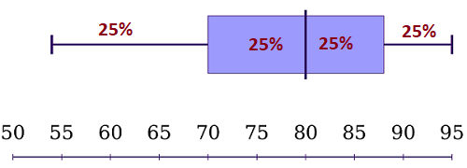
Example 1

Slide 40
Example 1: Interpretation
The box and whisker plot shows that 50% of the students have scores between 70 and 88 points.
In addition, 75% scored lower than 88 points, and 50% have test results above 80. So, if you have test results somewhere in the lower whisker, you may need to study more.

Slide 41
Example 2
Suppose an IT company has two stores that sell computers. The company recorded the number of sales each store made each month. In the past 12 months, we have the following numbers of sold computers:
Store 1:
350, 460, 20, 160, 580, 250, 210, 120, 200, 510, 290, 380.
Store 2:
520, 180, 260, 380, 80, 500, 630, 420, 210, 70, 440, 140.

Slide 42
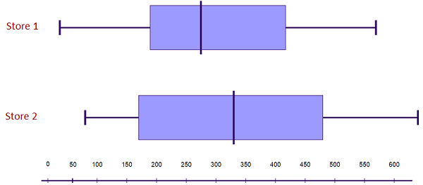
Example 2

Slide 43
Example 2: Interpretation
Store 2’s highest and lowest sales are both higher than Store 1’s relevant sales.
In addition, Store 2’s median sales value is higher than Store 1’s. Also, Store 2’s interquartile range is larger.
These results tell us that Store 2 consistently sells more computers than Store 1.

Slide 44
Frequency Tables
A frequency table is a tabular representation of data that shows the number of occurrences (frequency) of each unique value in the dataset.

Slide 45
Components of a Frequency Table
Categories or Intervals: The unique values or range of values (bins) in the dataset.
Frequency: The number of occurrences of each category or interval.
Relative Frequency: The proportion of the total number of observations that fall into each category or interval.
Cumulative Frequency: The sum of frequencies for all categories up to a given category or interval.

Slide 46
Creating a Frequency Table
Collect the Data: Obtain the dataset.
Organize the Data: List the unique values or define intervals (bins).
Count the Frequencies: Count the number of occurrences for each value or interval.

Slide 47
Example
Dataset: 3, 5, 7, 7, 8, 8, 8, 10, 12
Value | Frequency | Relative Frequency | Cumulative Frequency
3 | 1 | 1/9 ≈ 0.11 | 1
5 | 1 | 1/9 ≈ 0.11 | 2
7 | 2 | 2/9 ≈ 0.22 | 4
8 | 3 | 3/9 ≈ 0.33 | 7
10 | 1 | 1/9 ≈ 0.11 | 8
12 | 1 | 1/9 ≈ 0.11 | 9

Slide 48
Properties and Applications
Detailed Distribution: Provides an exact count of occurrences for each value.
Cumulative Analysis: Helps in understanding the cumulative distribution.
Relative Frequencies: Useful for comparing distributions of different sizes.

Slide 49
Histograms
A histogram is a graphical representation of the distribution of numerical data. It displays data using bars of different heights, where each bar represents an interval (bin) and the height corresponds to the frequency of values within that interval.

Slide 50
Components of a Histogram
Bins: Intervals that divide the range of data into equal parts.
Bars: Rectangles representing the frequency of data points within each bin.
X-Axis: Represents the range of data (bins).
Y-Axis: Represents the frequency of data points.

Slide 51
Creating a Histogram
Collect the Data: Obtain the dataset.
Determine the Number of Bins: Choose the number of intervals.
Create the Bins: Divide the range of data into equal intervals.
Count the Frequencies: Count the number of data points in each bin.
Draw the Bars: Plot the bars with heights corresponding to the frequencies.

Slide 52
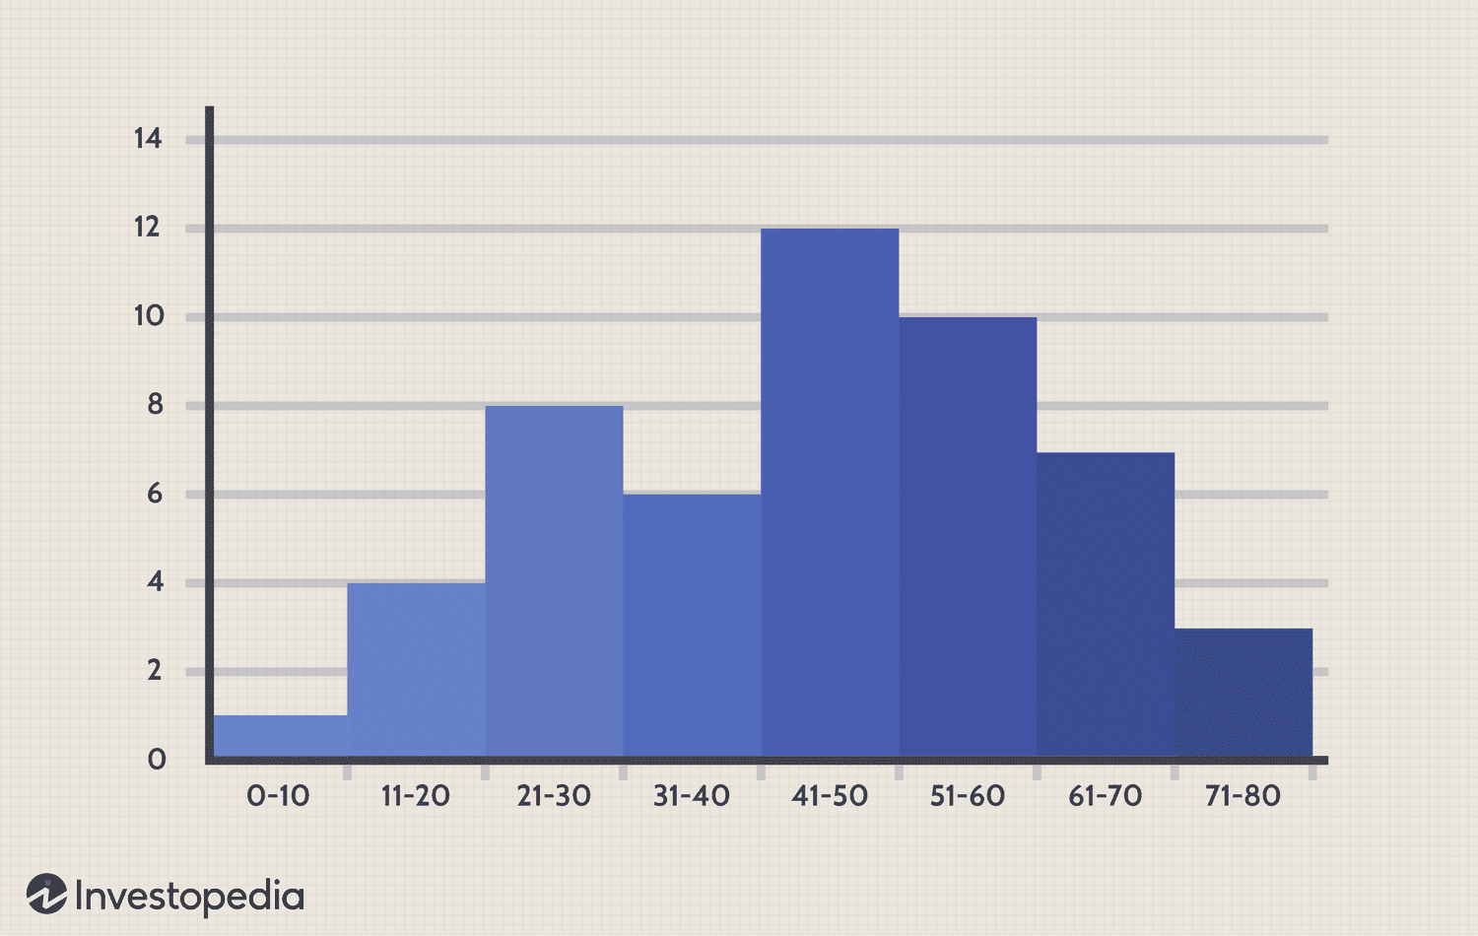
Example

Slide 53
Difference Between Histogram and Bar Graph
Histogram | Bar Graph
It is a two-dimensional figure | It is a one-dimensional figure
The frequency is shown by the area of each rectangle | The height shows the frequency and the width has no significance.
It shows rectangles touching each other | It consists of rectangles separated from each other with equal spaces.

Slide 54
Interpretation of Histograms
Shape: The overall shape of the histogram indicates the distribution (e.g., normal, skewed, bimodal).
Spread: The width of the bars (bins) and the range of the data.
Peaks: The highest bars indicate the mode(s) of the data.
Outliers: Bars that are separated from the main group indicate outliers.

Slide 55
Properties and Applications
Visual Distribution: Provides a visual summary of data distribution.
Identifying Patterns: Helps in identifying skewness, modality, and spread.
Comparative Analysis: Useful for comparing different datasets.

Slide 56
Problem
You are given a dataset representing the ages of participants in a local marathon. The dataset is as follows:
22,23,22,25,27,30,22,28,34,35,29,28,23,26,31,32,30,22,24,29,27,26,25,24,33,34,29,30,32,28,27,26,25,24,23,2222, 23, 22, 25, 27, 30, 22, 28, 34, 35, 29, 28, 23, 26, 31, 32, 30, 22, 24, 29, 27, 26, 25, 24, 33, 34, 29, 30, 32, 28, 27, 26, 25, 24, 23, 2222,23,22,25,27,30,22,28,34,35,29,28,23,26,31,32,30,22,24,29,27,26,25,24,33,34,29,30,32,28,27,26,25,24,23,22
Task:
Create a histogram of the ages.
Determine the most common age range of participants.
Calculate the mean and standard deviation of the ages.
Explain the distribution of ages based on the histogram.

Slide 57
Steps to Solve
Create the histogram:
Choose appropriate bin sizes.
Plot the histogram using the dataset.
Determine the most common age range:
Identify the bin with the highest frequency.
Calculate the mean and standard deviation:
Use the formulas for mean and standard deviation to calculate these values from the dataset.
Explain the distribution:
Analyze the shape of the histogram to describe the distribution (e.g., skewness, modality).

Slide 58
Density Plots
A density plot is a smoothed, continuous version of a histogram estimated from the data. It shows the distribution of the data over a continuous interval or time period. The area under the curve represents the entire dataset and sums to one.
Density plots are a useful way to visualize the distribution of a dataset, providing a smoothed version of a histogram. Unlike histograms, density plots estimate the probability density function of the continuous random variable, offering a continuous curve that represents the data distribution.

Slide 59
Key Concepts
Kernel Density Estimation (KDE): The process used to create a density plot. KDE smooths the data using a kernel function to estimate the probability density function.
Bandwidth: A parameter that controls the smoothness of the density plot. A smaller bandwidth leads to a more detailed plot, while a larger bandwidth results in a smoother plot.

Slide 60
Creating a Density Plot
Select a Kernel Function: Common choices include Gaussian (normal distribution), Epanechnikov, and Tophat.
Determine the Bandwidth: Select an appropriate bandwidth for smoothing.
Estimate the Density: Apply the kernel function and bandwidth to estimate the density at each point in the data range.

Slide 61
Creating a Density Plot
The bandwidth parameter in density estimation is similar to the bin width in histograms.
If the bandwidth is too small:
The density estimate can become overly peaky.
The visual representation may become busy.
Main trends in the data may be obscured.
If the bandwidth is too large:
Smaller features in the data distribution may disappear.
The choice of the kernel affects the shape of the density curve.
A Gaussian kernel tends to produce smooth, Gaussian-like density estimates.
A rectangular kernel can generate step-like appearances in the density curve.
With more data points, the choice of the kernel becomes less significant.
Density plots are reliable and informative for large data sets.
Density plots can be misleading for data sets with only a few points.

Slide 62
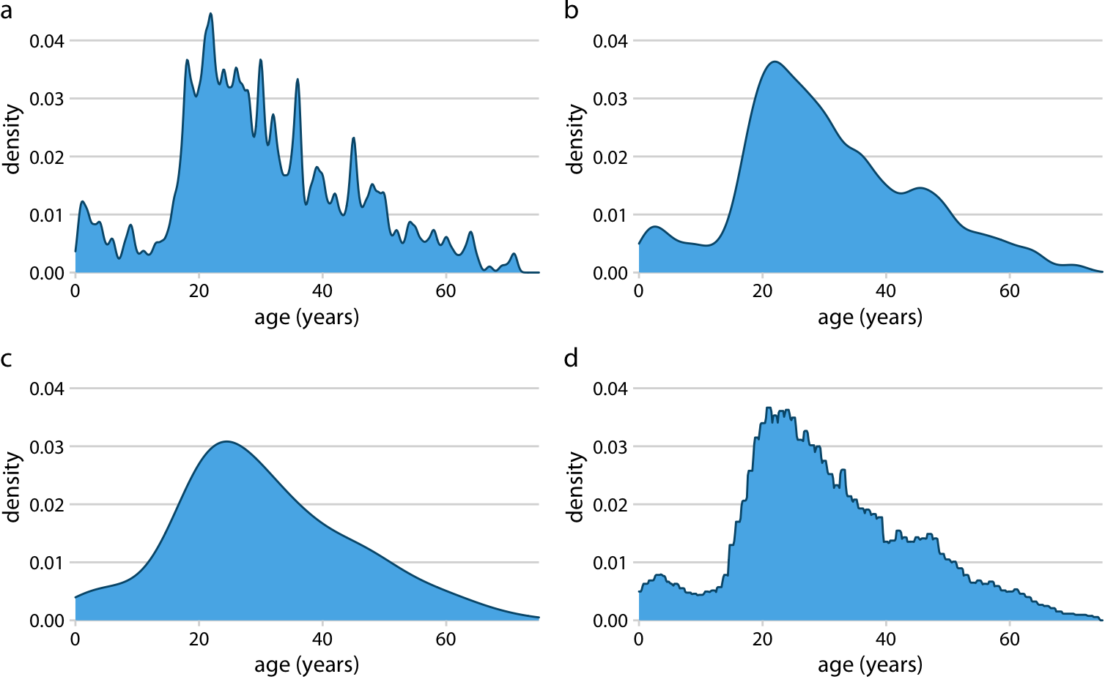
Creating a Density Plot
Kernel density estimates depend on the chosen kernel and bandwidth. Here, the same age distribution of Titanic passengers is shown for four different combinations of these parameters: (a) Gaussian kernel, bandwidth = 0.5; (b) Gaussian kernel, bandwidth = 2; (c) Gaussian kernel, bandwidth = 5; (d) Rectangular kernel, bandwidth = 2.

Slide 63
Properties and Applications
Smooth Representation: Provides a continuous view of the data distribution, unlike histograms which can appear blocky.
Comparison: Easier to compare multiple distributions on the same plot.
Outliers: Can help identify outliers by showing unusual peaks or spread.

Slide 64
Density Estimates
Density estimation involves estimating the probability density function of a continuous random variable from a sample of data. The goal is to infer the underlying distribution of the data.

Slide 65
Key Concepts
Probability Density Function (PDF): A function that describes the likelihood of a random variable to take on a particular value. The area under the PDF over an interval represents the probability that the variable falls within that interval.
Kernel Function: A function used in KDE to smooth the data. Common kernels include Gaussian, Epanechnikov, and Tophat.

Slide 66
Kernel Density Estimation (KDE)
Select a Kernel Function:
Gaussian Kernel: Most commonly used, assumes a normal distribution.
Epanechnikov Kernel: Optimal in a mean square error sense.
Tophat Kernel: Simple, uniform distribution within the bandwidth.
Choose Bandwidth: Determines the smoothness of the estimated density.
Small Bandwidth: Captures more detail, but may introduce noise.
Large Bandwidth: Smoother estimate, but may oversmooth the data.
Calculate KDE: Apply the kernel function to each data point and sum the contributions to get the density estimate.

Slide 67
Example Calculation
Given a dataset: 3, 5, 7, 7, 8, 8, 8, 10, 12
Choose a Kernel Function: Gaussian
Set the Bandwidth: 1 (for simplicity)
Estimate Density: Sum the Gaussian kernels centered at each data point.

Slide 68
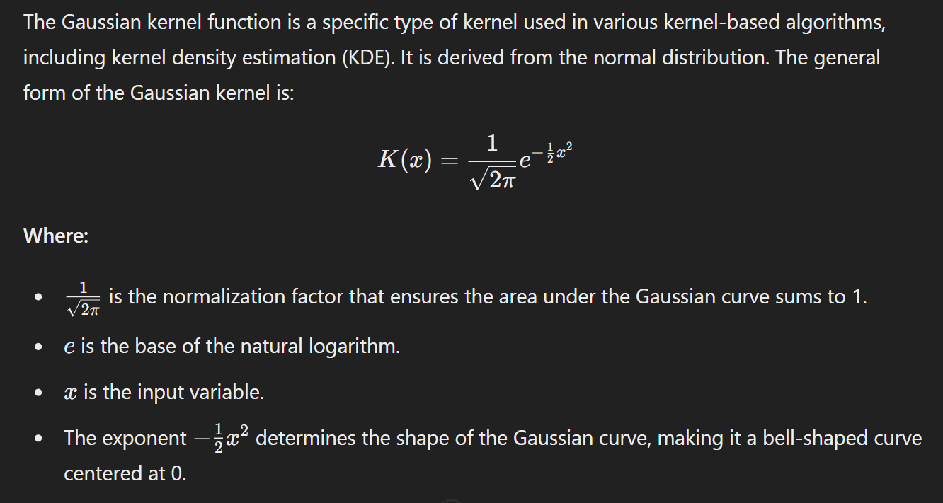
Gaussian Kernel Function

Slide 69
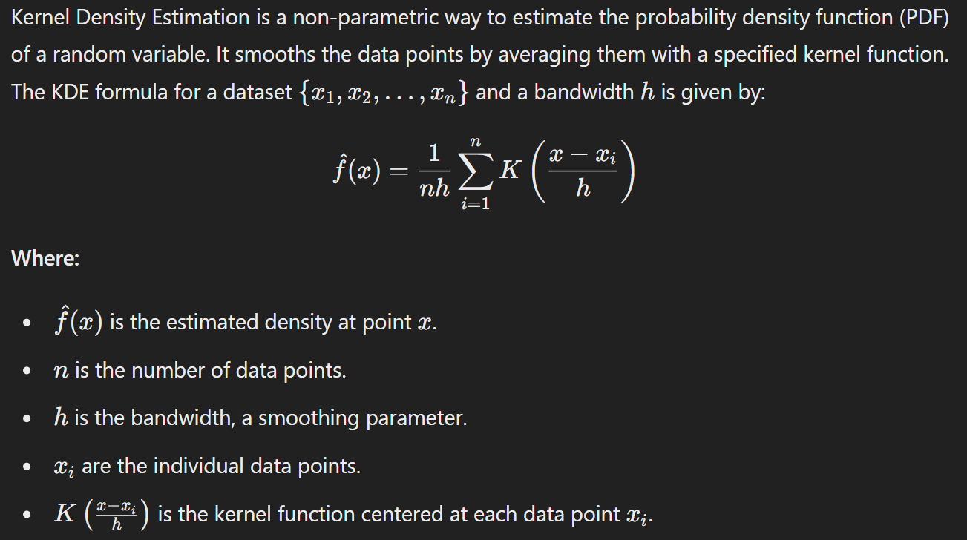
Kernel Density Estimation (KDE)

Slide 70
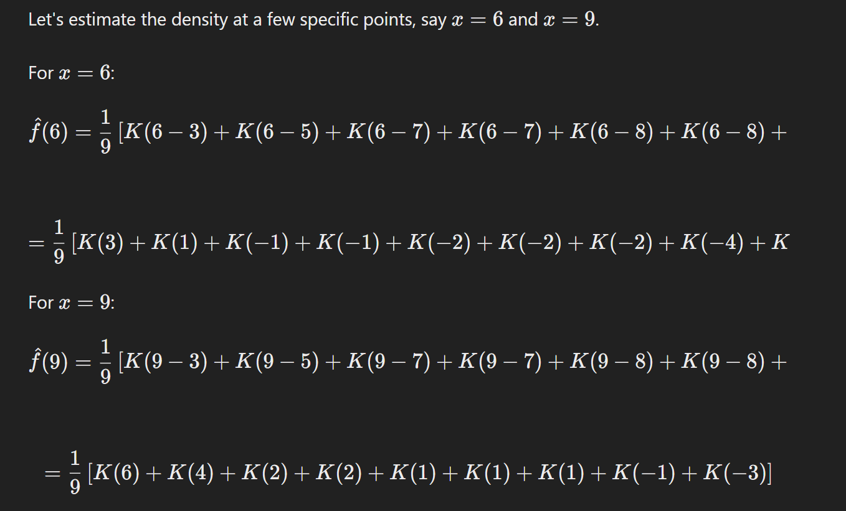
Kernel Density Estimation for Each Point

Slide 71
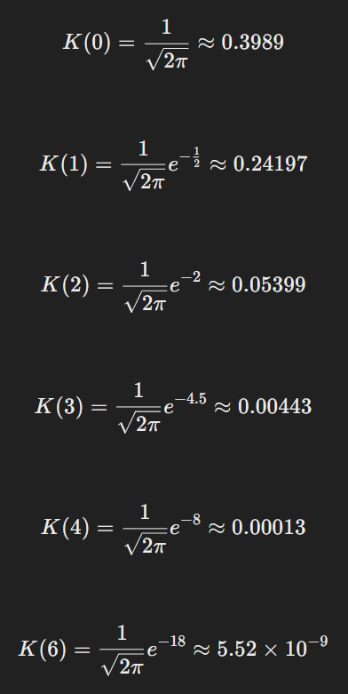
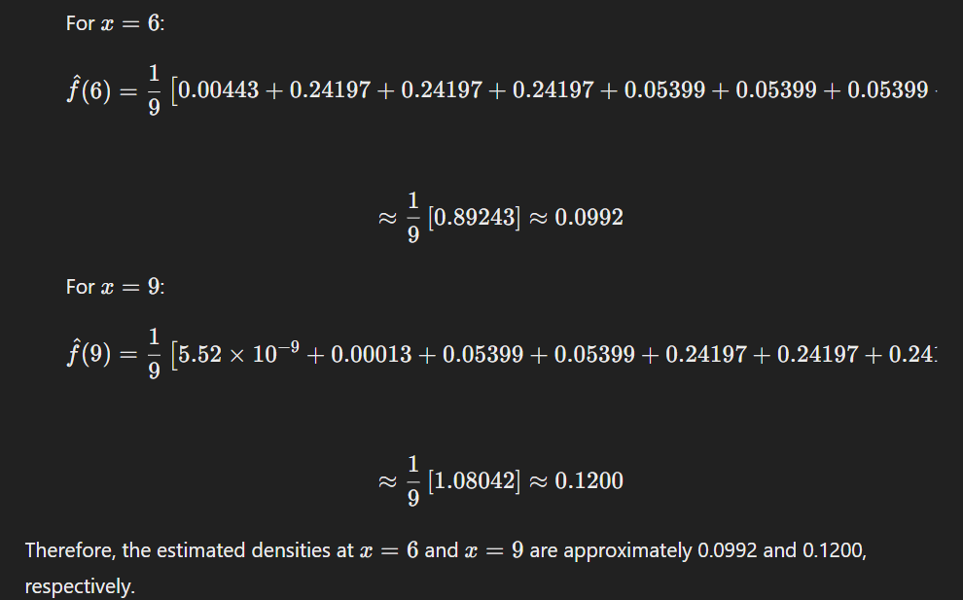
Evaluating the Gaussian Kernel and Value Plugin

Slide 72
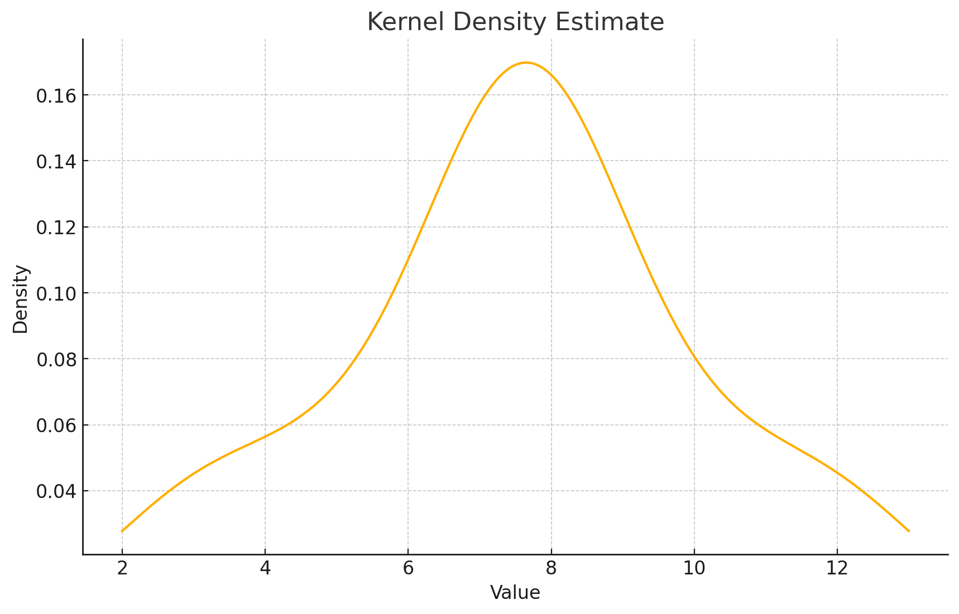
Example Calculation
import numpy as np
import matplotlib.pyplot as plt
from scipy.stats import gaussian_kde
# Sample data
data = np.array([3, 5, 7, 7, 8, 8, 8, 10, 12])
# Perform KDE
kde = gaussian_kde(data, bw_method=0.5)
x = np.linspace(min(data) - 1, max(data) + 1, 1000)
density = kde(x)
# Plot the density estimate
plt.plot(x, density)
plt.xlabel('Value')
plt.ylabel('Density')
plt.title('Kernel Density Estimate')
plt.show()

Slide 73
Comparison
Histograms:
Discrete representation with bins.
Bin size affects the appearance and interpretation.
Useful for quick and straightforward visualizations.
Density Plots:
Continuous representation of the data distribution.
Smoothing parameter (bandwidth) affects the appearance.
Better for comparing multiple distributions and understanding the overall shape.

Slide 74
Assignment
Create boxplots, histograms and density plots for at least three numerical columns in your dataset. Analyze the distributions and describe the data.

Slide 75
Expected Value
The expected value (E[X]) of a random variable is the long-run average value of repetitions of the experiment it represents. It is a measure of the center of the probability distribution of the variable.

Slide 76
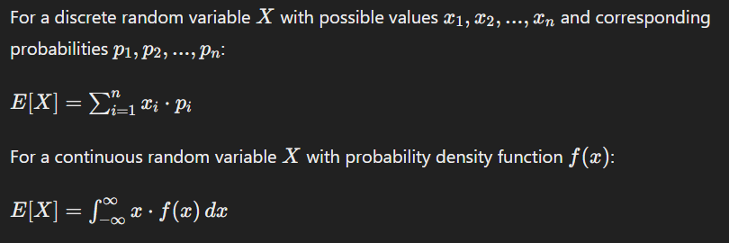
Expected Value Formula

Slide 77
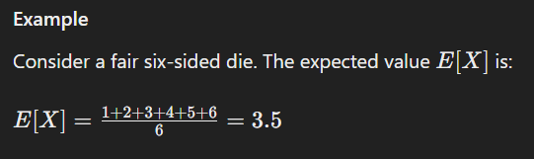
Expected Value Formula

Slide 78
Probability
Probability measures the likelihood of an event occurring. It ranges from 0 (impossible event) to 1 (certain event).

Slide 79
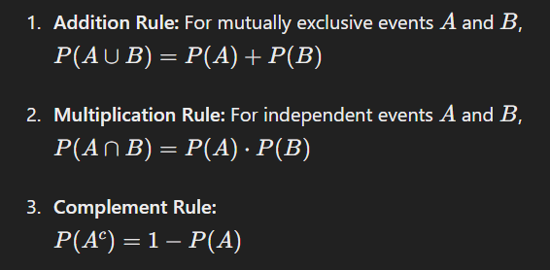
Basic Probability Rules

Slide 80
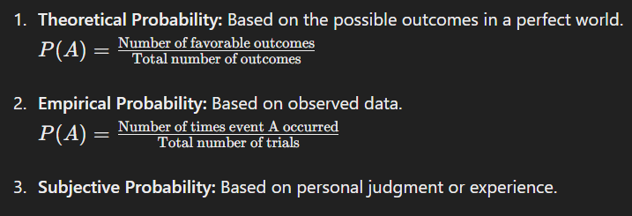
Types of Probability

Slide 81
Probability Distributions
Discrete Probability Distribution: Lists all possible values of a discrete random variable and their associated probabilities.
Continuous Probability Distribution: Described by a probability density function (PDF).

Slide 82
Correlation
Correlation measures the strength and direction of a linear relationship between two quantitative variables. The most common measure is the Pearson correlation coefficient.

Slide 83
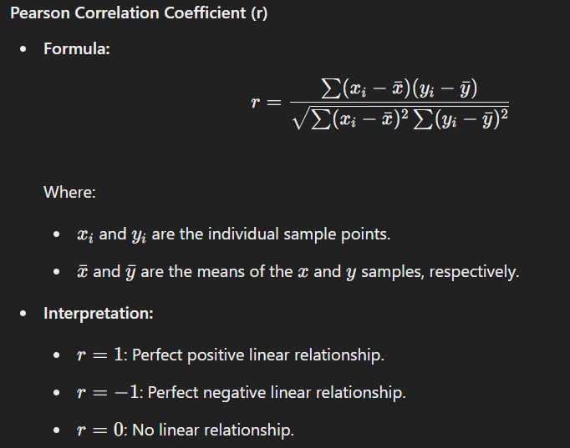
Correlation

Slide 84
Types of Correlation
Positive Correlation: Both variables increase or decrease together.
Negative Correlation: One variable increases while the other decreases.
Zero Correlation: No relationship between the variables.

Slide 85
Scatter Plot
A scatter plot is a graphical representation of the relationship between two variables. It helps visualize correlation by plotting data points on a Cartesian plane.

Slide 86
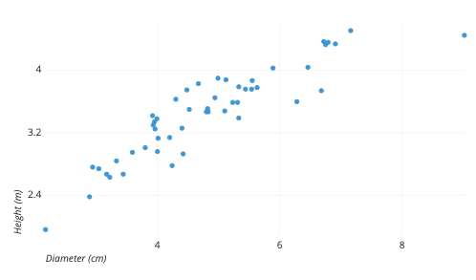
Example
The example scatter plot above shows the diameters and heights for a sample of fictional trees. Each dot represents a single tree; each point’s horizontal position indicates that tree’s diameter (in centimeters) and the vertical position indicates that tree’s height (in meters). From the plot, we can see a generally tight positive correlation between a tree’s diameter and its height. We can also observe an outlier point, a tree that has a much larger diameter than the others. This tree appears fairly short for its girth, which might warrant further investigation.

Slide 87
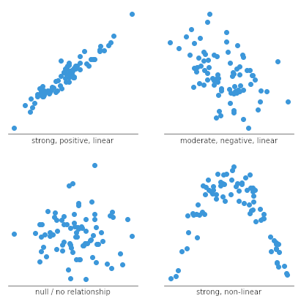
Interpretation

Slide 88
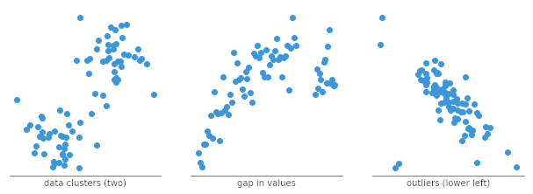
Interpretation

Slide 89
Assignment
Generate scatterplots for pairs of numerical columns in your dataset. Perform a correlation analysis and discuss any significant relationships.

Slide 90
Hexagonal Binning
Hexagonal binning is a method of plotting data where the plot area is divided into hexagons, and the number of data points within each hexagon is counted and visualized. It is particularly useful for visualizing large datasets and reducing overplotting.

Slide 91
Hexagonal Binning Benefits
Reduces Overplotting: Effective for large datasets where points overlap.
Reveals Density: Shows areas of high and low data point concentration.
Aesthetic Appeal: Hexagons fill the plotting area efficiently and provide a visually appealing representation.

Slide 92
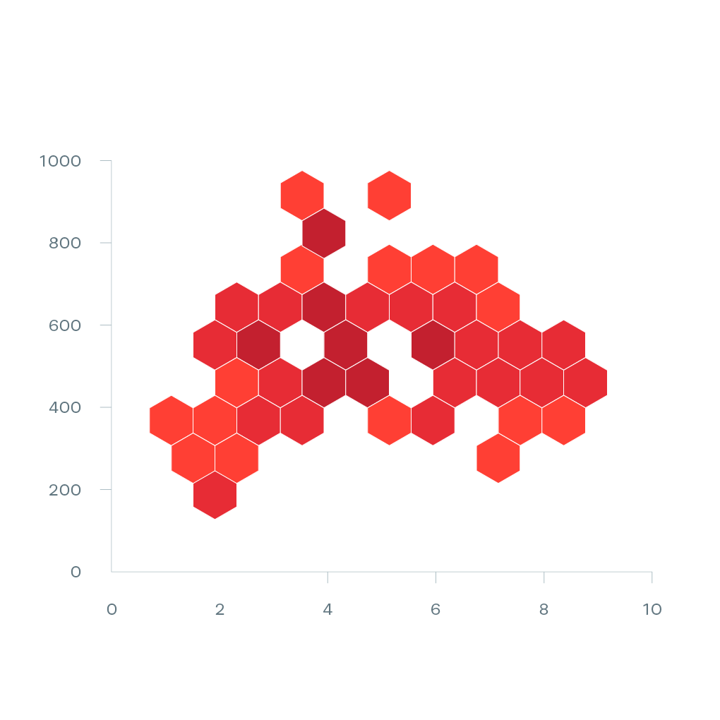
Hexagonal Binning

Slide 93
Hexagonal Binning Interpretation
Color Intensity: Represents the number of data points within each hexagon.
Hexagon Size (Grid Size): Determines the resolution of the plot. Smaller hexagons provide finer detail but may increase computational load.

Slide 94
Contour Plots
Contour plots are used to represent three-dimensional data in two dimensions. They display iso-contours, which are lines connecting points of equal value, often used to show the density or probability distribution of data points.

Slide 95
Contour Plots Benefits
Visualizing Density: Clearly shows regions of high and low density.
Gradient Information: Provides information about the gradient and slope of the data.
Comparison: Useful for comparing different datasets or variables.

Slide 96
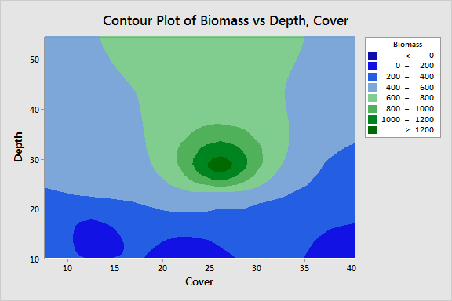
Contour Plots

Slide 97
Contour Plots Interpretation
Contour Lines: Lines connecting points of equal value. Closer lines indicate steeper gradients.
Color Intensity: Represents the magnitude of the variable being plotted.
Level Curves: Each curve represents a specific level of the variable, allowing for easy identification of regions with similar values.

Slide 98
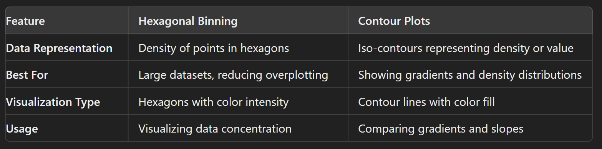
Comparison Between Hexagonal Binning and Contour Plots

Slide 99
Visualizing Multiple Variables
Visualizing multiple variables is essential for understanding complex datasets. It helps to uncover relationships, trends, and patterns among variables, providing deeper insights into the data.

Slide 100
Techniques for Visualizing Multiple Variables
1. Scatter Plot Matrix
Definition: A scatter plot matrix displays scatter plots for pairs of variables in a grid format, allowing the visualization of relationships between multiple pairs of variables simultaneously.
Key Features:
Diagonal: Typically shows histograms or density plots of individual variables.
Off-Diagonal: Shows scatter plots for each pair of variables.

Slide 101
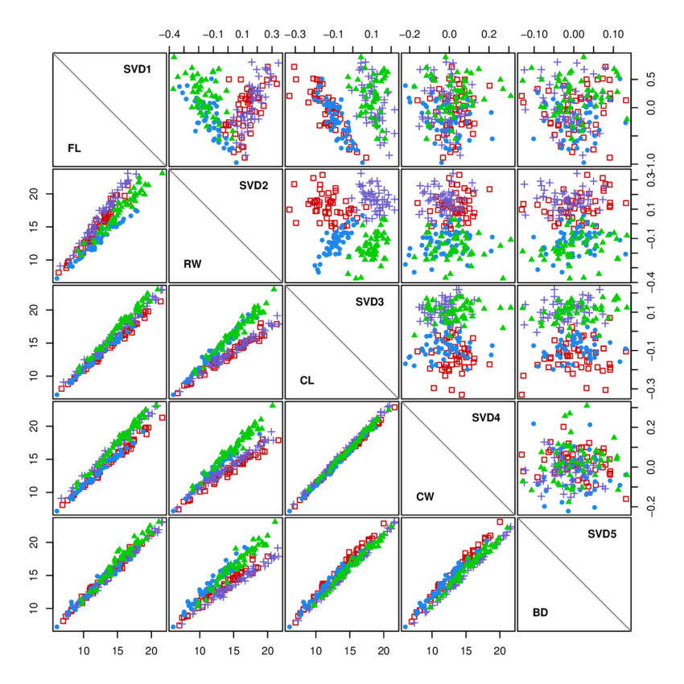
Techniques for Visualizing Multiple Variables

Slide 102
Techniques for Visualizing Multiple Variables
2. Heatmap
Definition: A heatmap uses color to represent the values of a matrix, where each cell's color intensity indicates the magnitude of the value.
Key Features:
Useful for displaying the correlation matrix.
Colors represent different values, making it easy to spot high or low correlations.

Slide 103
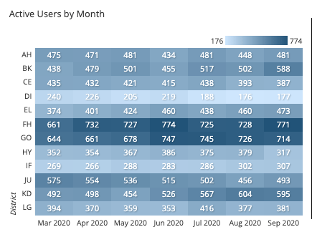
Techniques for Visualizing Multiple Variables

Slide 104
Techniques for Visualizing Multiple Variables
3. Parallel Coordinates Plot
Definition: A parallel coordinates plot visualizes multivariate data by plotting each variable on a separate axis and connecting corresponding values with lines.
Key Features:
Each line represents an observation.
Useful for comparing multiple variables across observations.

Slide 105
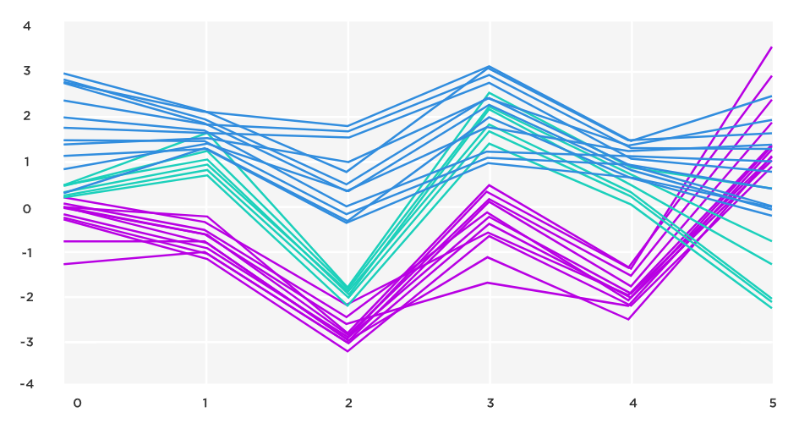
Techniques for Visualizing Multiple Variables

Slide 106
Techniques for Visualizing Multiple Variables
4. Pairwise Plot
Definition: Similar to a scatter plot matrix, pairwise plots display scatter plots for all pairs of variables, often combined with histograms or density plots on the diagonal.
Key Features:
Combines scatter plots and histograms/density plots.
Useful for examining relationships between multiple pairs of variables.

Slide 107
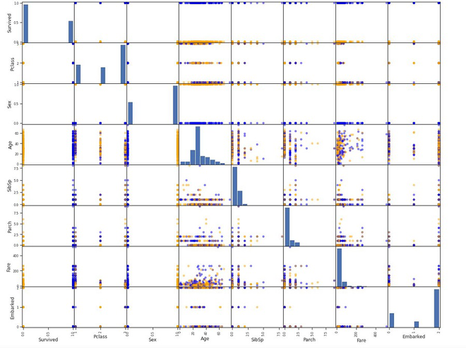
Techniques for Visualizing Multiple Variables

Slide 108
Techniques for Visualizing Multiple Variables
5. Bubble Plot
Definition: A bubble plot is an extension of the scatter plot where a third variable is represented by the size of the bubbles.
Key Features:
X-axis and Y-axis represent two variables.
Bubble size represents a third variable.
Useful for visualizing three-dimensional data.

Slide 109
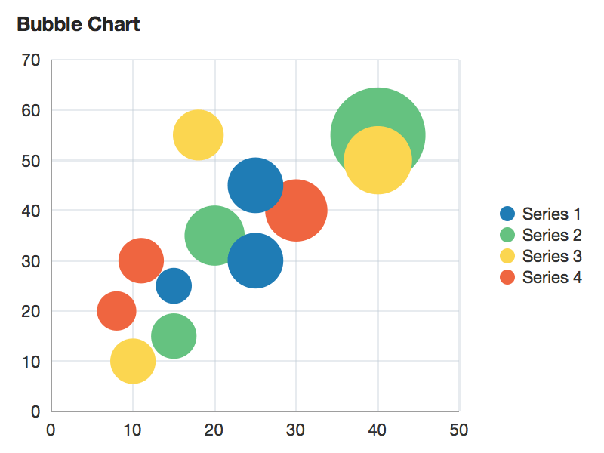
Techniques for Visualizing Multiple Variables

Slide 110
Techniques for Visualizing Multiple Variables
6. Multidimensional Scaling (MDS)
Definition: MDS is a technique used to visualize the similarity or dissimilarity of data in multiple dimensions by reducing them to a lower-dimensional space.
Key Features:
Projects high-dimensional data into 2D or 3D space.
Preserves the distances between points as much as possible.

Slide 111
Assignment
Perform a multivariate analysis with correlation studies and visualizations of multiple variables. Summarize your findings, interpret the visualizations, discuss challenges, and suggest areas for further investigation in a comprehensive report.

Slide 112
Bias
Bias is a systematic error that leads to incorrect estimates or conclusions in data analysis. It occurs when certain elements or groups within a dataset are over- or under-represented, resulting in skewed results.

Slide 113
Types of Bias
Selection Bias:
Occurs when the sample is not representative of the population.
Example: Surveying only university students to represent the general population.
Measurement Bias:
Arises from errors in data collection methods.
Example: Faulty weighing scales consistently underestimating weights.
Response Bias:
Happens when participants provide inaccurate responses.
Example: People underreporting socially undesirable behaviors in surveys.
Sampling Bias:
Occurs when some members of the intended population are less likely to be included in the sample.
Example: Using a telephone survey that excludes people without phones.
Survivorship Bias:
Involves focusing on surviving or existing cases and overlooking those that did not survive.
Example: Analyzing the performance of existing companies and ignoring those that went bankrupt.

Slide 114
Identifying and Minimizing Bias
Random Sampling:
Ensures that every member of the population has an equal chance of being included.
Example: Using random number generators to select survey participants.
Blinding:
Keeping participants and researchers unaware of group assignments to prevent bias.
Example: Double-blind clinical trials.
Standardizing Data Collection:
Using consistent methods and tools for data collection.
Example: Calibrating instruments regularly.
Using Large Samples:
Larger samples tend to be more representative of the population.
Example: National surveys with thousands of respondents.

Slide 115
Methods of Random Selection
Simple Random Sampling:
Every member of the population has an equal chance of being selected.
Example: Drawing names from a hat.
Systematic Sampling:
Selects every nth member of the population after a random start.
Example: Choosing every 10th person on a list after a random starting point.
Stratified Sampling:
Divides the population into strata and selects random samples from each stratum.
Example: Dividing a population by age groups and sampling from each group.
Cluster Sampling:
Divides the population into clusters and randomly selects entire clusters.
Example: Selecting random neighborhoods and surveying all households within them.

Slide 116
Size of Data
Size of data refers to the quantity of data points or observations in a dataset. Larger datasets generally provide more information and can lead to more robust and generalizable conclusions.

Slide 117
Advantages of Large Datasets
Increased Statistical Power:
Larger datasets reduce the margin of error and increase the reliability of statistical tests.
Example: In medical research, larger sample sizes can detect smaller effects with higher precision.
Better Representativeness:
Larger datasets are more likely to represent the population accurately.
Example: A national survey with thousands of respondents better captures population diversity.
Enhanced Machine Learning Performance:
Machine learning models often perform better with more data.
Example: Deep learning models, which require vast amounts of data for training.

Slide 118
Challenges of Large Datasets
Data Management:
Storing, processing, and analyzing large datasets require substantial computational resources.
Example: Big data platforms like Hadoop or Spark are often necessary for handling large-scale data.
Quality Control:
Ensuring the accuracy and consistency of large datasets can be challenging.
Example: Data cleaning and preprocessing become more complex with larger datasets.
Overfitting:
Models trained on very large datasets can sometimes overfit, capturing noise instead of the underlying pattern.
Example: A model that perfectly fits training data but performs poorly on new, unseen data.

Slide 119
Quality of Data
Quality of data refers to the accuracy, completeness, reliability, and relevance of the data. High-quality data ensures that the analysis is valid and the conclusions drawn are trustworthy.

Slide 120
Dimensions of Data Quality
Accuracy:
Data correctly represents the real-world values it is intended to model.
Example: Correctly recorded patient temperatures in a clinical trial.
Completeness:
All necessary data is present and accounted for.
Example: A customer database with no missing contact information.
Consistency:
Data is consistent across different datasets and systems.
Example: Uniform date formats across all records in a database.
Timeliness:
Data is up-to-date and available when needed.
Example: Real-time stock market data for financial analysis.
Validity:
Data conforms to the required formats and rules.
Example: Age entries in a database that are within a plausible range (e.g., 0-120 years).

Slide 121
Advantages of High-Quality Data
Accurate Analysis:
High-quality data leads to more accurate and reliable analysis.
Example: Predictive models built on accurate data are more likely to make correct predictions.
Better Decision Making:
High-quality data supports better decision-making processes.
Example: Businesses can make more informed strategic decisions based on reliable customer data.
Reduced Risk:
High-quality data minimizes the risk of errors and misinterpretations.
Example: Incorrect data in a financial report can lead to significant financial losses.

Slide 122
Challenges of Ensuring Data Quality
Resource Intensive:
Ensuring data quality can be time-consuming and resource-intensive.
Example: Manual data cleaning and validation processes.
Continuous Monitoring:
Data quality requires ongoing monitoring and maintenance.
Example: Regularly updating and auditing databases to maintain accuracy.
Complexity:
Ensuring data quality across multiple systems and sources can be complex.
Example: Integrating data from different departments within a large organization.

Slide 123
Balancing Size and Quality
Prioritize Data Quality:
Start with ensuring high data quality before expanding the dataset size.
Example: Validate data accuracy and completeness before scaling data collection efforts.
Incremental Data Collection:
Collect data in phases, ensuring quality at each stage.
Example: Pilot studies to refine data collection methods before large-scale implementation.
Leverage Technology:
Use advanced tools and technologies for data management and quality control.
Example: Automated data cleaning tools and real-time validation checks.
Quality Assurance Processes:
Implement robust quality assurance processes.
Example: Regular audits, validation checks, and data quality metrics monitoring.

Slide 124
Examples
Medical Research:
Balancing the need for large sample sizes with the requirement for accurate and reliable patient data.
Market Research:
Ensuring survey data is both comprehensive (size) and accurately reflects consumer preferences (quality).
Machine Learning:
Collecting large datasets for training while ensuring data labeling and features are accurate and relevant.

Slide 125
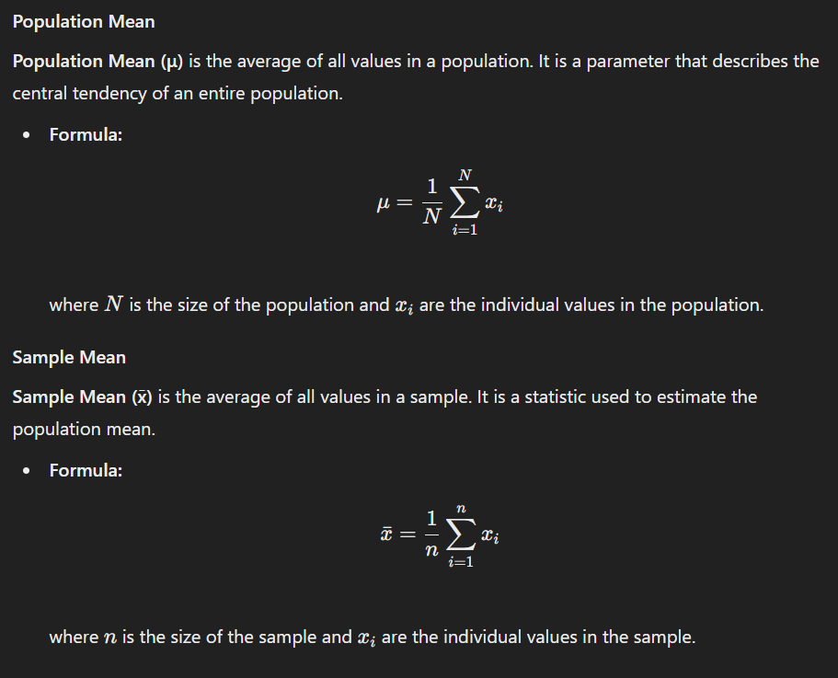
Sample Mean vs. Population Mean

Slide 126
Importance of Understanding the Difference
Inferential Statistics:
Sample means are used to make inferences about the population mean.
Example: Using the average height of a sample of students to estimate the average height of all students in a school.
Sampling Variability:
Different samples can produce different sample means.
Example: Two samples drawn from the same population can have slightly different means due to random variation.
Bias and Accuracy:
The sample mean is an unbiased estimator of the population mean if the sample is random.
Example: A properly conducted survey of voters can accurately estimate the population's voting preferences.

Slide 127
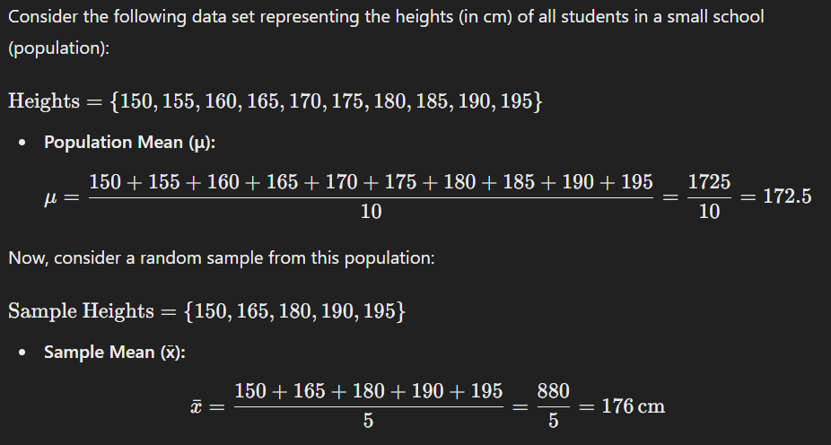
Calculating Sample and Population Means

Slide 128
Assignment
Create a simple random sample from your dataset. Compare the sample mean and population mean. Discuss any observed biases or differences.

Slide 129
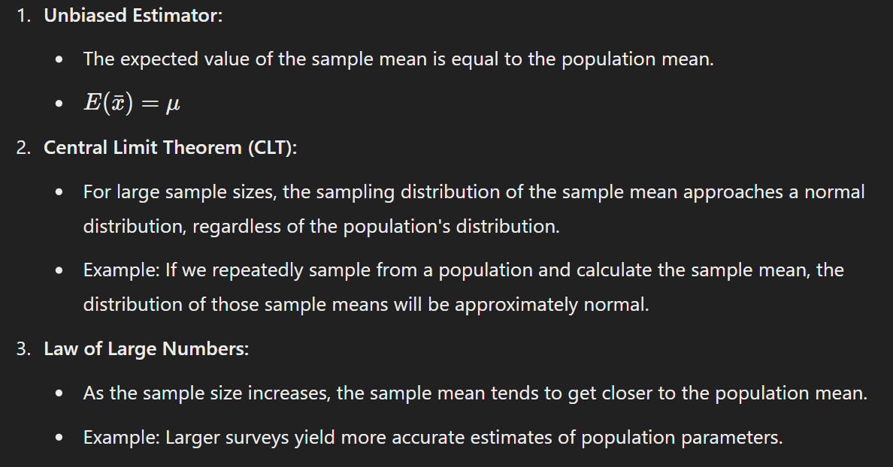
Properties of Sample Mean

Slide 130
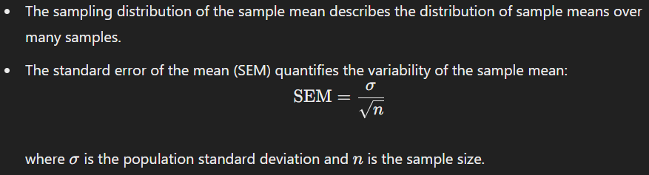
Sampling Distribution

Slide 131
Normal Distribution
A normal distribution, also known as a Gaussian distribution or bell curve, is a probability distribution that is symmetric about the mean, showing that data near the mean are more frequent in occurrence than data far from the mean. In a normal distribution:
Mean (μ) = Median = Mode
The curve is bell-shaped and symmetric
68% of data falls within 1 standard deviation (σ) of the mean
95% of data falls within 2σ of the mean
99.7% of data falls within 3σ of the mean

Slide 132
Other Distributions
Uniform Distribution
Every value within a range has an equal probability of occurring
No mode or median, only a mean
Used for random sampling or modeling events with equal likelihood
Poisson Distribution
Models the number of events occurring in a fixed interval
Used for count data, like number of defects or accidents
Mean (μ) and variance (σ^2) are equal
Binomial Distribution
Models the number of successes in a fixed number of trials
Each trial has a constant probability of success
Used for modeling binary outcomes, like coin tosses or medical trials

Slide 133
Other Distributions
Exponential Distribution
Models the time between events in a Poisson process
Used for modeling waiting times or lifetimes
Mean (μ) = 1/λ (rate parameter)
Skewed Distributions
Right-skewed: Most data points are on the left side, with extreme values on the right (e.g., income distribution)
Left-skewed: Most data points are on the right side, with extreme values on the left (e.g., housing prices)
6. Bimodal Distribution
Two distinct peaks, indicating two underlying distributions
Used for modeling data with two distinct groups or subpopulations
7. Multimodal Distribution
More than two peaks, indicating multiple underlying distributions
Used for modeling complex data with multiple subpopulations

Slide 134
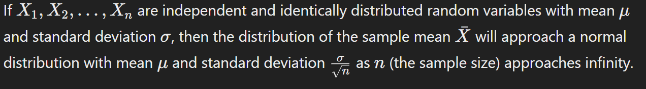
Central Limit Theorem

Slide 135
Why is the Central Limit Theorem Important?
Foundation for Inferential Statistics:
The CLT allows us to make inferences about population parameters using sample statistics.
Example: Estimating the population mean from the sample mean.
Justifies the Use of Normal Distribution:
Many statistical methods assume normality, and the CLT provides the theoretical basis for this assumption.
Example: Confidence intervals and hypothesis tests for the mean often rely on the normal distribution.
Applicability to Non-Normal Populations:
The CLT applies even if the population distribution is not normal, provided the sample size is large enough.
Example: Sampling from a skewed population, the distribution of the sample mean will still be approximately normal for large sample sizes.

Slide 136
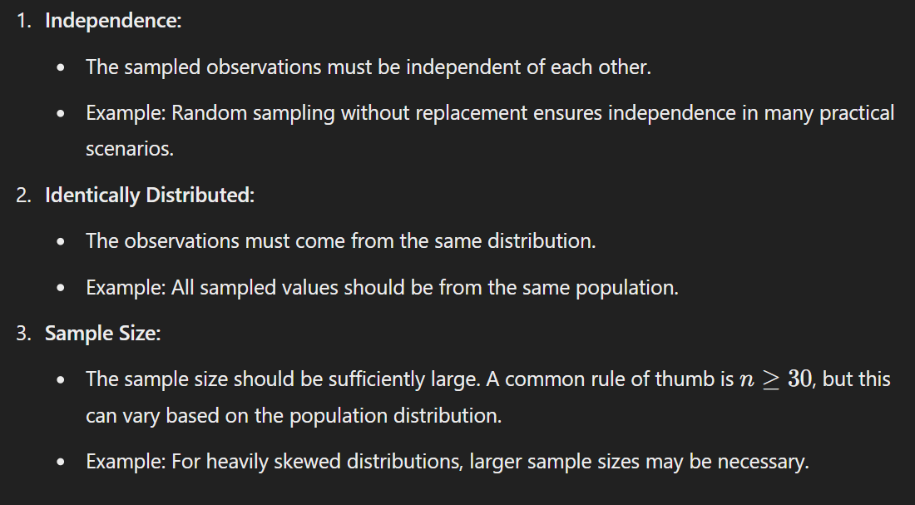
Conditions for the Central Limit Theorem

Slide 137
Practical Implications of the CLT
Confidence Intervals:
Confidence intervals for the mean can be constructed using the normal distribution, even if the population distribution is not normal.
Example: Constructing a 95% confidence interval for the mean weight of apples in a sample.
Hypothesis Testing:
Many hypothesis tests for the mean are based on the normal distribution, thanks to the CLT.
Example: Testing whether the mean height of a sample of plants differs from a known value.
Quality Control:
In manufacturing, the CLT is used to monitor product quality by sampling and analyzing the mean characteristics of products.
Example: Ensuring the average diameter of produced bolts meets specified standards.

Slide 138
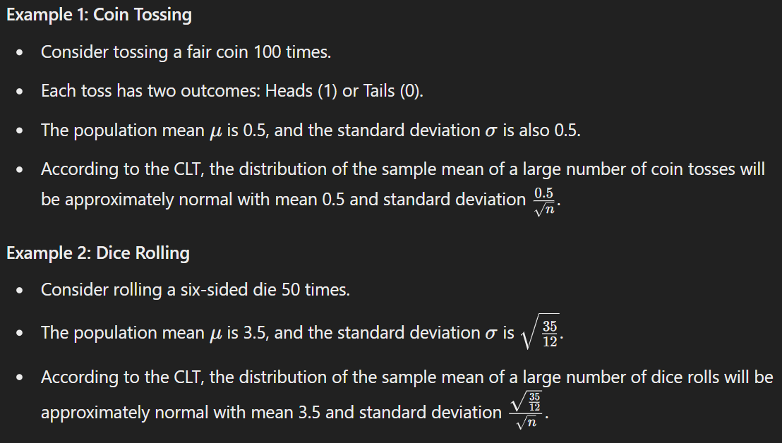
Examples

Slide 139
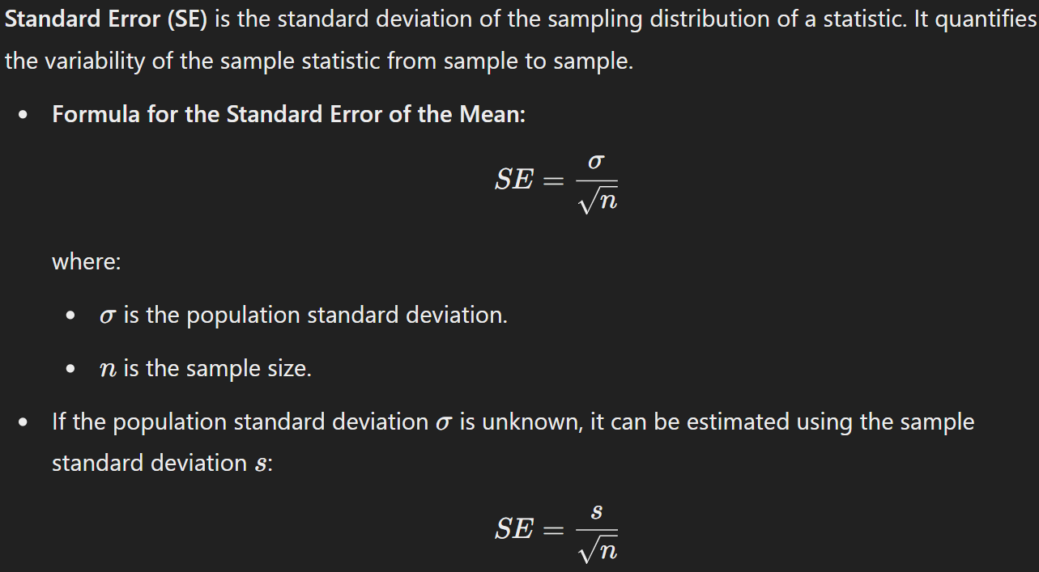
Standard Error

Slide 140
Importance of the Standard Error
Precision of Estimates:
SE indicates how precisely the sample statistic estimates the population parameter.
Example: A smaller SE suggests a more precise estimate of the population mean.
Confidence Intervals:
SE is used to construct confidence intervals for population parameters.
Example: Constructing a 95% confidence interval for the mean height of a sample of plants.
Hypothesis Testing:
SE is used in hypothesis tests to determine if observed data significantly differ from what is expected.
Example: Testing if the mean weight of a sample of fruits differs from a known value.

Slide 141
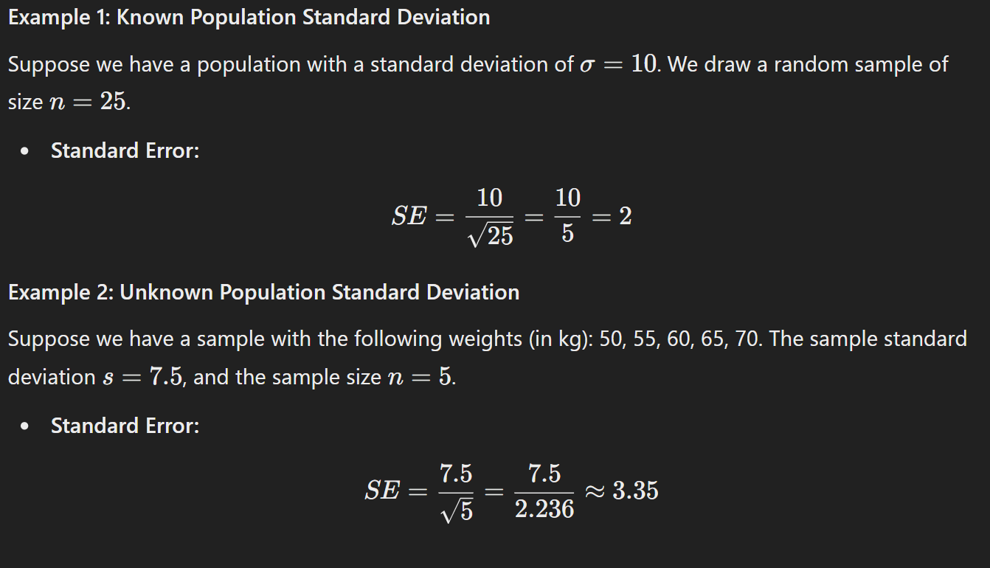
Calculation of Standard Error

Slide 142
Interpretation of Standard Error
Large SE:
Indicates more variability in the sample statistic.
Example: A large SE for the sample mean suggests that the sample means vary widely from sample to sample.
Small SE:
Indicates less variability in the sample statistic.
Example: A small SE for the sample mean suggests that the sample means are close to each other.

Slide 143
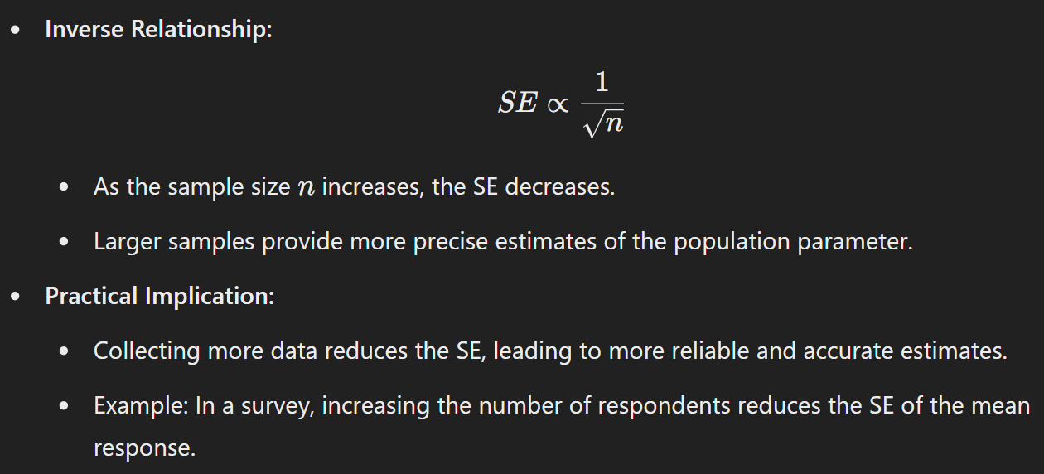
Relationship Between Standard Error and Sample Size

Slide 144
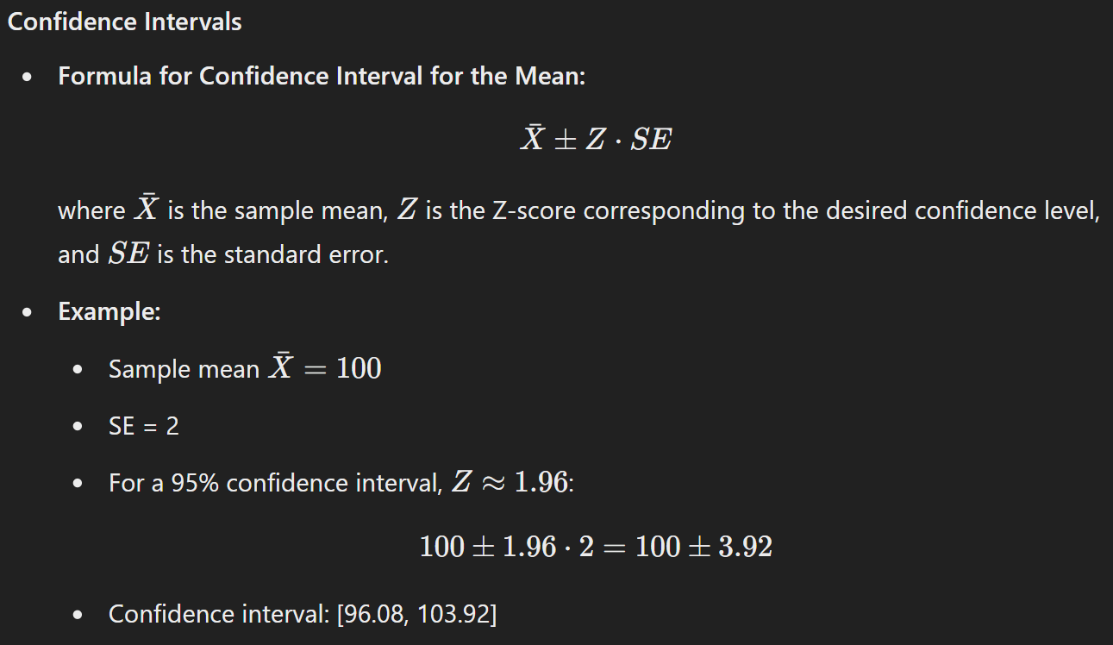
Standard Error in Practice

Slide 145

Standard Error in Practice

Slide 146
Confidence Intervals
Confidence intervals provide a range of values within which we expect a population parameter to lie, with a certain level of confidence. They are crucial in inferential statistics for estimating population parameters and understanding the precision of sample estimates.

Slide 147

Key Concepts

Slide 148

Constructing Confidence Intervals

Slide 149

Constructing Confidence Intervals

Slide 150

Constructing Confidence Intervals

Slide 151

Constructing Confidence Intervals

Slide 152

Constructing Confidence Intervals

Slide 153

Constructing Confidence Intervals

Slide 154
Interpretation
Correct Interpretation:
If we construct 100 confidence intervals from 100 different samples, approximately 95 of them will contain the true population parameter (for a 95% confidence level).
Incorrect Interpretation:
"There is a 95% probability that the true population parameter lies within this specific interval." (This is incorrect because the interval is fixed and the population parameter is not random.)

Slide 155
Factors Affecting the Width of a Confidence Interval
Sample Size (n):
Larger sample sizes result in narrower confidence intervals, indicating more precise estimates.
Confidence Level:
Higher confidence levels result in wider intervals, reflecting greater uncertainty.
Population Variability (σ or s):
Greater variability in the population results in wider confidence intervals.

Slide 156
The Bootstrap Method
The core idea of bootstrapping is to use the original sample data to generate many "bootstrap samples" by sampling with replacement. Each bootstrap sample is of the same size as the original sample.

Slide 157

Steps in Bootstrapping

Slide 158

Example of Bootstrapping

Slide 159
Applications of Bootstrapping
Confidence Intervals:
Constructing confidence intervals for statistics where traditional methods are difficult or unavailable.
Example: Constructing a 95% confidence interval for the median income of a population.
Hypothesis Testing:
Performing hypothesis tests for complex statistics.
Example: Testing the equality of medians from two independent samples.
Model Validation:
Validating the stability and performance of statistical models.
Example: Assessing the accuracy of a regression model by bootstrapping residuals.

Slide 160
Advantages of Bootstrapping
Flexibility:
Can be applied to a wide range of statistics and models.
Example: Estimating the median, standard deviation, regression coefficients.
Few Assumptions:
Does not require assumptions about the underlying population distribution.
Example: Useful for non-normal and small sample size data.
Practical for Complex Problems:
Applicable to statistics with complex sampling distributions.
Example: Estimating confidence intervals for a non-parametric estimator.

Slide 161
Disadvantages of Bootstrapping
Computationally Intensive:
Requires significant computational power, especially for large datasets and many bootstrap samples.
Example: Running bootstraps with large datasets may require advanced computing resources.
Dependence on Original Sample:
Results are heavily dependent on the original sample and may not perform well with small or biased samples.
Example: If the original sample is not representative, the bootstrap estimates may be biased.

Slide 162
Resampling vs. Bootstrapping
Resampling
Definition: General term for methods that involve repeatedly drawing samples from the original data.
Examples: Jackknife, permutation tests, cross-validation.
Bootstrapping
Definition: A specific resampling method that involves sampling with replacement and is primarily used for estimating the distribution of a statistic.
Focus: Generating many samples from the original data to estimate the sampling distribution of a statistic.

Slide 163

Standard Normal Distribution

Slide 164

Standard Normal Distribution Function

Slide 165

QQ-Plots

Slide 166
Steps to Create a QQ-Plot
Order Data:
Sort the data in ascending order.
Theoretical Quantiles:
Calculate the theoretical quantiles from the standard normal distribution.
Plot Data:
Plot the ordered data values against the corresponding theoretical quantiles.
Interpretation:
If the data is normally distributed, the points will fall approximately along a straight line.
Deviations from the line indicate departures from normality.

Slide 167

QQ-Plot Example

Slide 168
Importance of QQ-Plots
Assessing Normality:
Essential for determining whether parametric tests, which assume normality, are appropriate.
Example: Before performing a t-test, check if the data is normally distributed using a QQ-plot.
Identifying Outliers:
QQ-plots can help identify outliers that deviate significantly from the theoretical distribution.
Example: Points far from the line in a QQ-plot of residuals can indicate outliers.
Model Validation:
Used in validating the assumptions of statistical models, particularly linear regression.
Example: Checking the normality of residuals in a regression model.

Slide 169
Common Patterns in QQ-Plots
Normal Distribution:
Points fall along a straight diagonal line.
Skewed Distribution:
Points form a curve. Right skewness results in points below the line on the left and above the line on the right.
Heavy Tails:
Points are above the line on both ends and below the line in the middle, indicating a distribution with heavier tails than normal.
Light Tails:
Points are below the line on both ends and above the line in the middle, indicating a distribution with lighter tails than normal.

Slide 170
Long-Tailed Distribution
A long-tailed distribution is a type of distribution where the tail — the part of the distribution far from the mean — declines more slowly than an exponential distribution. These distributions have higher probabilities for extreme values (outliers).
Heavy-Tailed Distribution
A heavy-tailed distribution is another term often used interchangeably with long-tailed distribution, emphasizing the significant weight in the tail regions.

Slide 171
Properties of Long-Tailed Distributions
Slow Decline in Tail:
The probability of extreme values declines slower than in light-tailed distributions.
Infinite Moments:
Some long-tailed distributions have infinite variance or higher-order moments.
High Kurtosis:
Long-tailed distributions often exhibit high kurtosis, indicating heavy tails and sharp peaks.
Outliers:
Higher likelihood of extreme observations (outliers) compared to light-tailed distributions.

Slide 172
Examples of Long-Tailed Distributions
Pareto Distribution:
Often used to model wealth distribution, insurance claims, and other phenomena.
Cauchy Distribution:
Known for its heavy tails and undefined mean and variance.
Log-Normal Distribution:
Distribution of a variable whose logarithm is normally distributed.
Weibull Distribution:
Can exhibit heavy tails depending on the shape parameter.

Slide 173
Assignment
Using the bootstrap method, create a sampling distribution of the mean for a numerical column in your dataset, and plot the distribution to visualize the variability of the mean. Calculate the standard error to quantify this variability, and use it to construct and interpret 95% confidence intervals for the mean. Additionally, generate a QQ-plot to assess whether the data follows a normal distribution, which is essential for the validity of the confidence intervals and standard error estimates.

Slide 174
Probability Distribution Function (PDF)
A Probability Distribution Function (PDF) tells us how likely it is to get each possible value in a dataset. Think of it as a way to describe the pattern of outcomes for a random event. For example, if you roll a fair die, the PDF shows that each number (1, 2, 3, 4, 5, 6) has an equal chance of appearing.
For discrete data (like rolling a die), the PDF gives the probability of each specific outcome.
For continuous data (like heights of people), the PDF shows the probability density, which indicates how likely it is to get values within a certain range.

Slide 175
Cumulative Distribution Function (CDF)
A Cumulative Distribution Function (CDF) adds up the probabilities from the PDF to tell us the probability of getting a value less than or equal to a certain number. It helps us understand the probability of outcomes up to a certain point.
For example, if you want to know the probability of rolling a number less than or equal to 3 on a die, the CDF would add the probabilities of rolling a 1, 2, or 3.

Slide 176
Variety in PDFs and CDFs
Different distribution functions have different Probability Distribution Functions (PDFs) and Cumulative Distribution Functions (CDFs) because they describe different types of random processes and data patterns.

Slide 177
Variety in PDFs and CDFs
1. Different Types of Data
Discrete vs. Continuous: Some distributions are for discrete data (e.g., the number of heads in coin flips), while others are for continuous data (e.g., the height of people).
Count Data: The Poisson distribution models count data, like the number of emails received in an hour.
2. Different Situations and Assumptions
Normal Distribution: Assumes data is symmetrically distributed around a mean.
Binomial Distribution: Assumes a fixed number of trials with two possible outcomes (success or failure) in each trial.
Exponential Distribution: Models the time between events in a continuous process.

Slide 178
Variety in PDFs and CDFs
3. Different Patterns of Variability
Shape: Distributions can be symmetrical, skewed, have thick or thin tails. The shape of the PDF and CDF reflects this variability.
Spread: Some distributions might be tightly clustered around a mean (low variance), while others are spread out (high variance).
4. Specific Real-World Applications
Weibull Distribution: Used in reliability analysis and failure times because it can model different rates of failure over time.
Chi-Square Distribution: Used in hypothesis testing for categorical data.

Slide 179
How PDFs and CDFs Reflect These Differences
PDF Shape: The PDF shows the likelihood of different outcomes. For example, the normal distribution has a bell-shaped PDF, indicating most values are around the mean, while the exponential distribution has a decreasing PDF, showing the likelihood of longer waiting times decreases over time.
CDF Growth: The CDF shows the cumulative probability up to a point. For example, the CDF of a normal distribution grows smoothly and symmetrically, while the CDF of an exponential distribution grows quickly at first and then levels off.

Slide 180
Example Comparisons
Normal vs. Exponential: The normal distribution's PDF is symmetric around the mean, while the exponential distribution’s PDF is only for positive values and decreases exponentially.
Binomial vs. Poisson: The binomial distribution’s PDF is for a fixed number of trials, showing probabilities for each number of successes. The Poisson distribution’s PDF shows probabilities for the number of events happening in a fixed interval and can theoretically go to infinity.

Slide 181
Based on Data Type
A. Discrete Distributions
These distributions deal with countable outcomes.
Bernoulli Distribution: Describes a single experiment with two possible outcomes (success/failure).
Binomial Distribution: Describes the number of successes in a fixed number of independent Bernoulli trials.
Geometric Distribution: Describes the number of trials needed for the first success.
Poisson Distribution: Describes the number of events happening in a fixed interval of time or space, given a constant mean rate and independent occurrences.

Slide 182
Based on Data Type
B. Continuous Distributions
These distributions deal with outcomes that can take any value within a range.
Normal Distribution: Describes data that clusters around a mean with symmetric tails.
Exponential Distribution: Describes the time between events in a Poisson process.
Uniform Distribution: Describes data where every value in a range is equally likely.
Weibull Distribution: Used in reliability analysis and failure times.
Beta Distribution: Used to model the distribution of probabilities.
Gamma Distribution: Generalizes the exponential distribution to model waiting times for multiple events.

Slide 183
Based on Shape and Characteristics
A. Symmetric Distributions
These distributions have a mirror-image shape around their center.
Normal Distribution: Also known as the Gaussian distribution; characterized by its bell-shaped curve.
t-Distribution: Similar to the normal distribution but with heavier tails, used when sample sizes are small.

Slide 184
Based on Shape and Characteristics
B. Skewed Distributions
These distributions are not symmetric.
Exponential Distribution: Right-skewed, used to model time between events.
Weibull Distribution: Can be right-skewed or left-skewed depending on its parameters.

Slide 185
Based on Shape and Characteristics
C. Distributions with Bounded Support
These distributions are defined within a specific range.
Uniform Distribution: All outcomes within a range are equally likely.
Beta Distribution: Defined on the interval [0, 1], useful for modeling probabilities.

Slide 186
Based on Applications
A. Hypothesis Testing and Inference
Chi-Square Distribution: Used in tests of independence and goodness-of-fit.
t-Distribution: Used in estimating population parameters when the sample size is small.
F-Distribution: Used in comparing variances (ANOVA).

Slide 187
Based on Applications
B. Reliability and Life Data Analysis
Exponential Distribution: Models time until failure for a process with a constant failure rate.
Weibull Distribution: Models various types of failure rates, widely used in reliability engineering.

Slide 188
ANOVA (Analysis of Variance)
Analysis of Variance (ANOVA) is a statistical method used to compare the means of three or more groups to determine if at least one group mean is significantly different from the others. It is widely used in experimental design and analysis to test hypotheses about differences among group means.

Slide 189
ANOVA (Analysis of Variance)
The outcome of ANOVA is the ‘F statistic’. This ratio shows the difference between the within group variance and the between group variance, which ultimately produces a figure which allows a conclusion that the null hypothesis is supported or rejected. If there is a significant difference between the groups, the null hypothesis is not supported, and the F-ratio will be larger.

Slide 190
ANOVA terminology
Dependent variable: This is the item being measured that is theorized to be affected by the independent variables.
Independent variable/s: These are the items being measured that may have an effect on the dependent variable.
A null hypothesis (H0): This is when there is no difference between the groups or means. Depending on the result of the ANOVA test, the null hypothesis will either be accepted or rejected.

Slide 191
ANOVA terminology
An alternative hypothesis (H1): When it is theorized that there is a difference between groups and means.
Factors and levels: In ANOVA terminology, an independent variable is called a factor which affects the dependent variable. Level denotes the different values of the independent variable that are used in an experiment.
Fixed-factor model: Some experiments use only a discrete set of levels for factors. For example, a fixed-factor test would be testing three different dosages of a drug and not looking at any other dosages.
Random-factor model: This model draws a random value of level from all the possible values of the independent variable.

Slide 192
Types of ANOVA
One-Way ANOVA:
Used to compare the means of three or more independent groups based on one factor (independent variable).
Example: Comparing the average test scores of students from different schools.
Two-Way ANOVA:
Used to compare the means of groups based on two factors, which may have an interaction effect.
Example: Studying the effects of different teaching methods and gender on test scores.
Repeated Measures ANOVA:
Used when the same subjects are measured multiple times under different conditions.
Example: Measuring the effect of a drug on the same group of patients at different time points.

Slide 193
Assumptions of ANOVA
Independence:
The observations in each group must be independent of each other.
Normality:
The data in each group should be approximately normally distributed.
Homogeneity of Variance (Homoscedasticity):
The variance within each group should be roughly equal.

Slide 194

One-Way ANOVA

Slide 195

ANOVA Table

Slide 196

F-statistic

Slide 197
Decision Rule
Calculate the F-statistic using the formula above.
Compare the calculated F-statistic to the critical value from the F-distribution table at a chosen significance level (e.g., α=0.05).
If the calculated F-statistic is greater than the critical value, reject the null hypothesis (H0​).

Slide 198
Problem
A researcher wants to test if there is a significant difference in the average scores of students taught by three different teaching methods. The researcher collects the following data:
Group 1 (Method A): 85, 88, 90, 92, 87
Group 2 (Method B): 78, 85, 86, 83, 82
Group 3 (Method C): 91, 89, 93, 95, 92
Is there a statistically significant difference in the mean scores among the three teaching methods at a significance level of α=0.05?

Slide 199

Two-Way ANOVA

Slide 200

ANOVA Table for Two-Way ANOVA

Slide 201

ANOVA Table for Two-Way ANOVA

Slide 202
Decision Rule
Calculate the F-statistics for the main effects and interaction effect.
Compare each F-statistic to its critical value from the F-distribution table.
Reject the null hypothesis for any factor if its F-statistic is greater than the critical value.

Slide 203
Post-Hoc Tests
If the null hypothesis is rejected in ANOVA, it indicates that at least one group mean is different, but it does not specify which groups differ. Post-hoc tests are used to make pairwise comparisons between group means to determine which specific means differ.
Tukey's HSD (Honestly Significant Difference): A commonly used post-hoc test to compare all pairs of group means while controlling for Type I error.
Bonferroni Correction: Adjusts the significance level when performing multiple comparisons to reduce the chance of Type I errors.

Slide 204
Assumptions and Limitations
ANOVA Assumptions:
Independence of observations.
Normality of the residuals.
Homogeneity of variances (equal variances across groups).
Violations:
Non-Normality: If the data are not normally distributed, the results may be inaccurate.
Unequal Variances: Violating the homogeneity of variances can lead to misleading conclusions. The Welch’s ANOVA can be used as an alternative when variances are unequal.
Limitations:
ANOVA only tells you that there is a difference between groups but not which groups are different. Post-hoc tests are required for that.
Sensitive to outliers, which can distort results.

Slide 205
Chi-Square Test
The Chi-Square test is a statistical method used to determine whether there is a significant association between categorical variables. It is applicable when the data consists of frequencies or counts rather than continuous data. The Chi-Square test is widely used in hypothesis testing, especially in testing relationships between categorical variables and checking for goodness of fit.

Slide 206
Types of Chi-Square Tests
Chi-Square Test of Independence:
Used to determine whether there is a significant association between two categorical variables in a contingency table.
Example: Testing if there is an association between gender and voting preference.
Chi-Square Goodness-of-Fit Test:
Used to determine whether an observed frequency distribution differs significantly from an expected theoretical distribution.
Example: Testing if a die is fair based on observed rolls.

Slide 207
Assumptions of the Chi-Square Test
The data must be in the form of counts or frequencies in discrete categories.
Observations must be independent. This means each data point belongs to one category only.
The expected frequency in each cell of the contingency table should be at least 5 to ensure the validity of the test.
The sample size should be large enough to provide reliable results.

Slide 208

Chi-Square Test of Independence

Slide 209

Chi-Square Test of Independence

Slide 210

Chi-Square Test of Independence

Slide 211

Chi-Square Goodness-of-Fit Test

Slide 212
Fisher’s Exact Test
Fisher’s Exact Test is a statistical significance test used to determine whether there is a non-random association between two categorical variables in a contingency table. It is particularly useful when the sample size is small, and the assumptions of the Chi-Square test are not met, such as when expected frequencies in the table are less than 5.

Slide 213
Fisher’s Exact Test
Categorical Variables:
Fisher’s Exact Test is applied when analyzing categorical (qualitative) data.
Example: Testing whether there is a relationship between gender (male/female) and preference for a product (like/dislike).
Contingency Table:
A contingency table is a matrix format where rows and columns represent different categories of the variables. Fisher’s Exact Test is typically used for 2x2 tables but can be extended to larger tables.
Exact Test:
Unlike the Chi-Square test, Fisher's Exact Test calculates the exact probability of observing the given distribution of data under the null hypothesis, without relying on large-sample approximations.

Slide 214

Fisher’s Exact Test

Slide 215


Contingency Table

Slide 216

Contingency Table

Slide 217


Slide 218

P-value interpretation

Slide 219
Two-Tailed or One-Tailed Test?
Two-tailed test: Used when you are testing whether there is any association (positive or negative) between the two variables. This is the most commonly used version of Fisher's Exact Test.
Two-tailed p-value: It accounts for tables that are as extreme as the observed one, in both directions (i.e., in favor of either outcome or group).
One-tailed test: Used when you are specifically testing for an association in one direction (either positive or negative). For instance, you might be interested in whether Group 1 has a significantly higher chance of Outcome 1 compared to Group 2, and not in the opposite direction.
One-tailed p-value: Only considers tables that are extreme in one direction.

Slide 220
Relevance of Fisher’s Exact Test for Data Science
Small Sample Sizes:
Fisher’s Exact Test is particularly valuable when dealing with small datasets, where the expected frequencies in some cells are too small for a Chi-Square test to be valid. It ensures the accuracy of statistical inference even with limited data.
Testing Relationships Between Categorical Variables:
In data science, we often deal with categorical variables (e.g., customer behavior, demographics). Fisher’s Exact Test helps assess the strength and significance of associations between these variables, guiding decisions about product features, marketing strategies, and more.
Feature Selection:
In supervised learning, Fisher's Exact Test can be used as part of feature selection to identify which categorical features are significantly associated with the target variable. For example, in a classification problem, Fisher’s test can help identify whether a particular feature has a significant association with the class labels.

Slide 221
Relevance of Fisher’s Exact Test for Data Science
Medical and A/B Testing:
In clinical trials or A/B testing with small sample sizes, Fisher's Exact Test is used to evaluate whether treatment effects or variations in outcomes are statistically significant. For instance, comparing the effectiveness of a drug against a placebo or testing different designs for a webpage to assess user engagement.
Handling Sparse Data:
Fisher's Exact Test is well-suited for situations with sparse data (where many cells in the contingency table have small values), ensuring accurate p-values in situations where other tests may provide misleading results.
Precise Probability Calculations:
In contrast to approximate methods like the Chi-Square test, Fisher’s Exact Test provides an exact p-value, which can be critical in data-driven decisions requiring high precision (e.g., sensitive medical or financial decisions).

Slide 222
t-Tests
A t-test is a statistical hypothesis test used to compare the means of two groups to determine if they are significantly different from each other. It is often used when the population standard deviation is unknown, and the sample size is small. The t-test assumes that the data is approximately normally distributed, and it helps evaluate whether any observed differences in sample means are statistically significant.

Slide 223
Types of t-Tests
One-Sample t-Test:
Compares the sample mean to a known population mean to determine if they are significantly different.
Example: Testing if the average height of students in a class is different from the national average height.
Independent (Two-Sample) t-Test:
Compares the means of two independent groups to determine if they are significantly different.
Example: Testing if the average salary of employees at two different companies is the same.
Paired (Dependent) t-Test:
Compares the means of two related groups (e.g., before-and-after measurements) to determine if they are significantly different.
Example: Testing if a training program has improved employee performance by comparing pre-training and post-training scores.

Slide 224

One-Sample t-Test

Slide 225

One-Sample t-Test

Slide 226

Independent (Two-Sample) t-Test

Slide 227

Independent (Two-Sample) t-Test

Slide 228

Paired (Dependent) t-Test

Slide 229

Paired (Dependent) t-Test

Slide 230

One-Tailed vs. Two-Tailed t-Test

Slide 231

Power of a Test

Slide 232

Type I and Type II Errors

Slide 233
Factors Affecting Power

Slide 234

Power Calculation

Slide 235

Sample Size Calculation

Slide 236
Cumulative Distribution Function
The Cumulative Distribution Function (CDF) of a random variable provides the probability that the variable takes a value less than or equal to a given value. Methods based on the CDF are widely used in statistical analysis, particularly in non-parametric testing, probability estimation, and assessing the goodness of fit of models.

Slide 237

Cumulative Distribution Function

Slide 238

Cumulative Distribution Function

Slide 239

Applications of CDF-Based Methods

Slide 240

Applications of CDF-Based Methods

Slide 241

Applications of CDF-Based Methods

Slide 242

Applications of CDF-Based Methods

Slide 243

Applications of CDF-Based Methods

Slide 244
Applications in Data Science
Goodness-of-Fit Testing:
CDF-based methods are extensively used to check whether data follow a specified distribution (e.g., normality tests in regression analysis). For example, the Kolmogorov-Smirnov and Anderson-Darling tests can be used to validate assumptions about data distributions.
Survival Analysis:
In survival analysis, the CDF is used to calculate survival probabilities and to model time-to-event data. The Kaplan-Meier estimator is a commonly used non-parametric estimator for the survival function, which is closely related to the empirical CDF.
Non-Parametric Testing:
Many non-parametric tests, such as the Mann-Whitney U test, are based on ranks or the empirical CDF, making them useful in situations where assumptions of normality or equal variance are violated.
Probability Estimation:
The CDF is used in probability estimation tasks, such as finding the probability that a variable will fall within a given range or above/below a certain value. This is particularly useful in fields like finance, where estimating the probability of rare events is important.
Q-Q Plots in Model Validation:
In machine learning and regression analysis, Q-Q plots are used to validate model assumptions, such as the normality of residuals, to ensure that models are performing as expected.

Slide 245
Advantages and Disadvantages of CDF-Based Methods
Advantages:
Non-Parametric:
Methods based on the empirical CDF are non-parametric and make few assumptions about the underlying distribution, making them flexible and widely applicable.
Visual Tools:
Methods like Q-Q plots provide powerful visual tools to assess whether a dataset follows a specific distribution, which helps in model diagnostics and data analysis.
Applicability to Small Samples:
CDF-based methods can be applied to small sample sizes, where parametric tests might not perform well.

Slide 246
Advantages and Disadvantages of CDF-Based Methods
Disadvantages:
Sensitivity to Sample Size:
Some CDF-based tests, like the Kolmogorov-Smirnov test, may have limited power with small sample sizes or may be overly sensitive with very large samples, detecting trivial deviations from the theoretical distribution.
Computationally Intensive:
Certain methods, such as the Cramer-von Mises and Anderson-Darling tests, involve complex calculations, which can be computationally intensive for large datasets.

Slide 247
The Empirical CDF (ECDF)
The Empirical Cumulative Distribution Function (ECDF) is a non-parametric estimator of the Cumulative Distribution Function (CDF) for a dataset. It provides a way to visualize and analyze the distribution of data points and is widely used in exploratory data analysis, hypothesis testing, and statistical modeling. Unlike theoretical CDFs, which assume a specific distribution, the ECDF is based directly on the observed data, making it flexible and assumption-free.

Slide 248

The Empirical CDF (ECDF)

Slide 249

Properties of the Empirical CDF

Slide 250
Properties of the Empirical CDF

Slide 251

How to Construct the Empirical CDF

Slide 252

How to Construct the Empirical CDF

Slide 253
Applications of the Empirical CDF
Exploratory Data Analysis (EDA):
The ECDF is commonly used in EDA to visualize the distribution of the data without making any assumptions about the underlying distribution.
It allows for a clear view of how data points are distributed, highlighting features such as concentration, gaps, or outliers.
Comparison of Distributions:
The ECDF is a useful tool for comparing the distributions of different samples. By plotting the ECDFs of two or more samples on the same graph, you can visually compare how the distributions differ.
A more formal comparison can be made using the Kolmogorov-Smirnov test, which compares the ECDFs of two samples.
Goodness-of-Fit Testing:
The ECDF can be used to assess whether a dataset fits a particular theoretical distribution. For example, you can compare the ECDF of a sample to the theoretical CDF of a normal distribution to see if the data is normally distributed.
The Q-Q plot (Quantile-Quantile plot) is one graphical tool that uses the ECDF to check for goodness-of-fit.
Confidence Intervals for the CDF:
Confidence intervals can be constructed for the ECDF to give a range of plausible values for the true underlying CDF. These intervals are useful for assessing the uncertainty around the estimated distribution of the data.
Survival Analysis:
In survival analysis, the ECDF plays a central role in estimating the survival function, which is the probability that a subject survives beyond a certain time point.

Slide 254
Advantages and Disadvantages of the ECDF
Advantages:
Non-parametric:
The ECDF does not require any assumptions about the underlying distribution of the data, making it a flexible tool for data analysis.
Complete Information:
The ECDF provides a complete summary of the data’s distribution. It shows the cumulative frequency of observations and can be used to visualize the entire distribution without losing any information.
Easy to Calculate:
The ECDF is simple to compute and visualize, even for small datasets.

Slide 255
Advantages and Disadvantages of the ECDF
Disadvantages:
Step Function:
Since the ECDF is a step function, it can be less smooth and harder to interpret for continuous data compared to fitted parametric distributions.
The step-like nature of the ECDF might not provide an intuitive understanding of the overall distribution, especially with sparse data.
Less Power for Hypothesis Testing:
In some cases, parametric methods (e.g., fitting a normal distribution) can provide more powerful hypothesis tests if the assumptions hold true, as they leverage more information from the data.
Sensitive to Outliers:
The ECDF can be sensitive to outliers, as large jumps occur at each data point, including extreme values.

Slide 256
Comparison to Parametric CDFs
The ECDF is a data-driven approach and makes no assumptions about the underlying distribution, whereas parametric CDFs assume that the data follows a specific distribution (e.g., normal, exponential, binomial).
Parametric CDFs are useful when you have prior knowledge or assumptions about the distribution, but the ECDF is more flexible when such assumptions cannot be made.

Slide 257
The Survival Function
The Survival Function is a fundamental concept in survival analysis, a branch of statistics that deals with the analysis of time-to-event data. The survival function represents the probability that an individual or object will survive beyond a certain time. It is commonly used in medical research, reliability engineering, and other fields where time until an event (e.g., death, failure) is of interest.

Slide 258

The Survival Function

Slide 259

Relationship Between the Survival Function and the Cumulative Distribution Function (CDF)

Slide 260

Properties of the Survival Function

Slide 261
Density Curves
A density curve is a graphical representation of the distribution of a continuous random variable. It shows the overall pattern of the data by illustrating how the values are distributed across the range of possible values. The area under a density curve represents probabilities, and for a probability distribution, the total area under the curve is always equal to 1. Density curves are widely used in statistics to visualize distributions and understand their characteristics.

Slide 262
Density Curves
Properties of Density Curves:
Non-negative: The curve cannot dip below the x-axis; it must always be at or above 0.
Total Area = 1: The total area under the curve is always equal to 1, representing the fact that the total probability for all possible outcomes of a random variable is 100%.
Interpretation:
The height of the density curve at a given point represents the likelihood of the random variable taking values near that point. Higher regions of the curve correspond to values that are more likely.
Probabilities are calculated by finding the area under the curve between two points.

Slide 263

Probability Density Function (PDF)

Slide 264

Common Density Curves

Slide 265

Common Density Curves

Slide 266

Common Density Curves

Slide 267
Histograms vs. Density Curves
A histogram is an approximation of a density curve. It divides the data into bins and shows the frequency or proportion of observations in each bin.
A density curve is a smooth representation of the data's distribution, which can be overlaid on a histogram to provide a clearer view of the data's overall pattern.
A common method for estimating the density curve from data is kernel density estimation (KDE).

Slide 268
Kernel Density Estimation (KDE)
KDE is a non-parametric method for estimating the probability density function of a random variable based on a finite sample.
KDE smooths out the data points and creates a continuous curve that represents the distribution.
The bandwidth of the KDE controls the smoothness of the resulting curve; a smaller bandwidth results in a more detailed, but less smooth, curve.

Slide 269
Stem-and-Leaf Plots
A stem-and-leaf plot is a graphical method used to display quantitative data. It is similar to a histogram but retains the original data values, which allows for a more detailed and precise visualization. Stem-and-leaf plots are particularly useful for small to moderately sized datasets and are often used in exploratory data analysis to quickly assess the distribution, central tendency, and spread of the data.

Slide 270
Stem-and-Leaf Plots
A stem-and-leaf plot breaks each data point into two parts:
Stem: The leading digit(s) of the data point (representing the tens, hundreds, etc.).
Leaf: The last digit (usually representing the ones or tenths place, depending on the scale).

Slide 271
How to Create a Stem-and-Leaf Plot
Sort the Data:
Arrange the data points in ascending order.
Determine Stems:
Divide each data point into a stem and a leaf.
The stem represents the leading digits, and the leaf represents the last digit.
If necessary, you can adjust the scale of the stems (e.g., group tens, hundreds, or fractional digits).
List Stems Vertically:
List the unique stem values in ascending order in a column.
Add Leaves:
For each stem, write the corresponding leaf values horizontally next to the stem.
The leaves should be listed in ascending order to make the plot easier to interpret.
Title and Key:
Provide a title or label for the plot and include a key to clarify how the stems and leaves are interpreted (e.g., “Stem 4 | 7 means 47”).

Slide 272

Stem-and-Leaf Plots

Slide 273
Stem-and-Leaf Plots
Advantages:
Retains Original Data:
Unlike histograms or bar charts, stem-and-leaf plots preserve the actual data values, making it easy to see individual points.
Quick Visualization:
Stem-and-leaf plots are useful for quickly visualizing the distribution, central tendency, and variability of the data.
Useful for Small Data Sets:
Stem-and-leaf plots work best for small to moderately sized datasets (usually fewer than 100 points).
Shows Data Shape and Distribution:
Provides a clear view of the shape of the data distribution, including any clustering of values, gaps, or outliers.

Slide 274
Stem-and-Leaf Plots
Disadvantages:
Limited Use for Large Data Sets:
For large datasets, stem-and-leaf plots can become cluttered and difficult to interpret. They are less useful when the number of data points exceeds 100.
Not Effective for Continuous Data:
For very precise or continuous data, stem-and-leaf plots can lose clarity, especially if decimal places are involved.
Choice of Stems and Leaves Can Affect Interpretation:
The choice of how to break the data into stems and leaves can influence the interpretation of the data. Poor choices in stem selection can make the plot misleading.

Slide 275
Measures of Location
Measures of location (also known as measures of central tendency) are statistical metrics used to describe the central point or typical value within a dataset. They provide a way to summarize a set of data with a single value that represents the "center" or "location" of the data. These measures help us understand where the data is concentrated, and they play a key role in data analysis and interpretation.

Slide 276

Key Measures of Location

Slide 277

Key Measures of Location

Slide 278

Key Measures of Location

Slide 279

Additional Measures of Location

Slide 280

Additional Measures of Location

Slide 281

Additional Measures of Location

Slide 282
Additional Measures of Location

Slide 283

Additional Measures of Location

Slide 284
Comparison of Measures of Location
Mean vs. Median:
The mean is affected by extreme values (outliers), while the median is not. This makes the median a better measure for skewed data.
For symmetric distributions, the mean and median will be approximately the same.
Mean vs. Mode:
The mean considers all data points, while the mode only considers the most frequent value. The mode can be useful for categorical data, while the mean is better suited for numerical data.
Geometric vs. Arithmetic Mean:
The geometric mean is better suited for datasets involving growth rates or percentages, as it better handles multiplicative effects.
The arithmetic mean is more commonly used in general numerical data.
Harmonic Mean vs. Arithmetic Mean:
The harmonic mean is used when averaging rates or ratios, while the arithmetic mean is used for standard numerical data.

Slide 285
Applications of Measures of Location
Descriptive Statistics:
Measures of location are essential in summarizing datasets and providing a clear picture of the "center" or typical value of the data.
Commonly used in summary statistics for reports, surveys, and research studies.
Economics and Business:
The mean is widely used in business for calculating averages like revenue, costs, or salaries.
The geometric mean is often used in finance for calculating average growth rates, such as returns on investments over time.
Medicine:
The median is frequently used in medical studies to represent the "typical" outcome, especially when the data is skewed or contains outliers (e.g., survival times).
Engineering and Physics:
The harmonic mean is used in fields like physics and engineering to average rates and ratios, such as the average speed over equal distances.

Slide 286
Applications of Measures of Location
Descriptive Statistics:
Measures of location are essential in summarizing datasets and providing a clear picture of the "center" or typical value of the data.
Commonly used in summary statistics for reports, surveys, and research studies.
Economics and Business:
The mean is widely used in business for calculating averages like revenue, costs, or salaries.
The geometric mean is often used in finance for calculating average growth rates, such as returns on investments over time.
Medicine:
The median is frequently used in medical studies to represent the "typical" outcome, especially when the data is skewed or contains outliers (e.g., survival times).
Engineering and Physics:
The harmonic mean is used in fields like physics and engineering to average rates and ratios, such as the average speed over equal distances.

Slide 287

Advanced Location Estimates

Slide 288

Advanced Location Estimates

Slide 289

Advanced Location Estimates

Slide 290

Advanced Location Estimates

Slide 291

Advanced Location Estimates

Slide 292

Advanced Location Estimates

Slide 293

Advanced Location Estimates

Slide 294
Comparison of Advanced Location Estimates
Trimmed Mean vs. Winsorized Mean:
Both the trimmed mean and Winsorized mean handle outliers by reducing their influence, but the trimmed mean discards extreme values entirely, while the Winsorized mean replaces them with the nearest remaining values.
M-Estimator vs. Arithmetic Mean:
The M-estimator is more robust than the traditional arithmetic mean because it minimizes a loss function that is less sensitive to outliers, making it more reliable for data that is not normally distributed or contains extreme values.
Median Absolute Deviation (MAD) vs. Standard Deviation:
MAD is a robust alternative to the standard deviation. While the standard deviation is sensitive to outliers, MAD provides a more resistant estimate of variability.
Hodges-Lehmann Estimator vs. Median:
The Hodges-Lehmann estimator is closely related to the median but is more efficient when the data is symmetric, making it a robust alternative to both the mean and the median.

Slide 295
Measures of Dispersion
Measures of dispersion (also known as measures of variability or spread) describe how much the data in a dataset varies around a central value. While measures of location (like the mean or median) provide a central point, measures of dispersion give insights into the distribution's spread, indicating whether the data points are close to the center or widely scattered. Understanding the spread is essential in statistical analysis as it helps assess the reliability and consistency of the data.

Slide 296
Comparison of Measures of Dispersion
Variance vs. Standard Deviation:
Variance measures the squared deviations from the mean, making it harder to interpret due to squared units. Standard deviation, as the square root of variance, brings the measure back to the same scale as the data and is more interpretable.
Range vs. Interquartile Range (IQR):
The range is highly sensitive to outliers, as it only considers the extreme values. The IQR focuses on the middle 50% of the data and is more robust, making it a better choice when data is skewed or contains outliers.
Mean Absolute Deviation (MAD) vs. Standard Deviation:
MAD is less sensitive to outliers because it uses absolute values, while standard deviation is more sensitive because it squares the deviations. MAD is often preferred in cases where robustness is important.
Coefficient of Variation (CV) vs. Standard Deviation:
The CV is a relative measure of dispersion that allows for comparison between datasets with different scales, while the standard deviation is an absolute measure that does not account for differences in the mean.

Slide 297
Types of Data Summarization Techniques
Descriptive Statistics:
Descriptive statistics involve calculating summary measures that describe the central tendency, variability, and overall distribution of the data.
Common measures include:
Measures of Location: Mean, median, mode.
Measures of Dispersion: Range, variance, standard deviation, interquartile range (IQR).
Measures of Shape: Skewness, kurtosis.
Tabular Summarization:
Presenting data in tables is a common way to summarize categorical and numerical data.
Examples include:
Frequency Tables: Show the count of occurrences for each category or range of values.
Contingency Tables: Display the frequency distribution of two or more categorical variables.
Cross-tabulation: Used to summarize the relationship between two categorical variables in matrix form.
Graphical Summarization:
Graphs and plots help visualize the data and reveal patterns, trends, or outliers.
Examples include:
Histograms: Show the frequency distribution of a single numerical variable.
Bar Charts: Compare different categories with their frequencies or values.
Pie Charts: Illustrate proportions of categories as parts of a whole.
Boxplots: Summarize the distribution of numerical data, showing the median, quartiles, and potential outliers.
Scatterplots: Visualize relationships between two numerical variables.

Slide 298
Types of Data Summarization Techniques
Numerical Summarization:
Involves computing summary statistics to represent key features of the dataset. Some commonly used techniques include:
Five-Number Summary: Provides a quick overview of a dataset using five key values: minimum, first quartile (Q1), median, third quartile (Q3), and maximum.
Moments: Mean (1st moment), variance (2nd moment), skewness (3rd moment), and kurtosis (4th moment).
Percentiles: Indicates the value below which a given percentage of observations fall (e.g., 90th percentile).
Correlation Coefficient: Measures the strength and direction of the relationship between two variables (e.g., Pearson or Spearman correlation).
Dimensionality Reduction:
For large datasets with many variables, dimensionality reduction techniques summarize the data by reducing the number of features while retaining most of the variability or structure.
Common techniques include:
Principal Component Analysis (PCA): Transforms the data into a set of uncorrelated variables (principal components) that capture the most variance.
Factor Analysis: Identifies underlying factors that explain the correlations among observed variables.
t-SNE (t-distributed Stochastic Neighbor Embedding): Reduces dimensionality while preserving the structure of high-dimensional data for visualization.
Linear Discriminant Analysis (LDA): Maximizes the separation between multiple classes for classification problems.
Aggregation and Grouping:
Aggregation techniques summarize data by grouping it based on one or more variables and computing summary statistics for each group.
Common methods include:
Group by: In databases or programming languages (e.g., SQL or Python), data can be grouped by one or more categorical variables, and summary statistics (e.g., mean, sum, count) can be computed for each group.
Pivot Tables: In Excel or similar tools, pivot tables allow you to summarize and analyze data by organizing it in a matrix format and applying aggregation functions (e.g., sum, average, count) for rows and columns.

Slide 299
Tasks
1. Data Exploration and Summarization
a) Create a comprehensive summary of your dataset using descriptive statistics and visualizations.
b) Plot the empirical cumulative distribution function (ECDF) for at least two numerical columns and compare them with their theoretical CDFs.
c) Create quantile-quantile plots for different columns and interpret any deviations from normality.
d) Calculate and compare different measures of location (mean, median, trimmed mean) and dispersion (IQR, standard deviation) for numerical columns.
e) Create boxplots to visualize the distribution of numerical variables across different groups.

Slide 300
Tasks
2. Hypothesis Testing and A/B Testing
a) Design an A/B test using your dataset. Clearly state your null and alternative hypotheses.
b) Conduct the A/B test using an appropriate statistical test (e.g., t-test, chi-square test).
c) Calculate the p-value and interpret the significance of your results.
d) Discuss the potential impact of multiple testing on your results.
3. Advanced Statistical Techniques
a) Perform a permutation test to compare two groups in your dataset. Use resampling techniques to estimate p-values.
b) Conduct a one-way ANOVA test to compare means across multiple groups. Interpret the F-statistic and post-hoc tests if applicable.
c) Perform a chi-square test for independence on categorical data in your dataset.
d) Use Fisher's Exact Test on a contingency table from your dataset. Compare the results with the chi-square test and discuss when each test is more appropriate.

Slide 301
Tasks
4. Power Analysis and Sample Size
a) For one of your hypothesis tests, calculate the power of the test.
b) Determine the required sample size for a given effect size in your dataset.
c) Discuss how changes in sample size might affect your study's conclusions.
5. Bootstrap Analysis
a) Use bootstrap resampling to estimate the variability of location estimates (e.g., mean, median) in your dataset.
b) Create confidence intervals for these estimates using the bootstrap results.
c) Discuss the advantages and limitations of bootstrap methods in your analysis.

Slide 302
Tasks
6. Comprehensive Report
Compile a comprehensive report of your findings, including:
a) An executive summary of your main findings.
b) Detailed methodology for each analysis performed.
c) Visualizations and tables to support your results.
d) Interpretation of all statistical tests and their practical significance.
e) Discussion of any limitations in your analysis and potential future directions.

Slide 303
Tasks
Deliverables
A Jupyter notebook or R Markdown file containing all your code and analysis.
A written report (PDF format) summarizing your findings, methodologies, and interpretations.
A 10-minute presentation highlighting the key insights from your analysis.
Evaluation Criteria
Correct application of statistical techniques
Depth and quality of data exploration and visualization
Clarity and accuracy of interpretations
Thoughtfulness in discussing limitations and implications
Overall presentation and organization of the report

Slide 304
The Kruskal-Wallis Test
The Kruskal-Wallis test is a non-parametric statistical test used to determine whether there are significant differences between the medians of three or more independent groups. It is the non-parametric alternative to one-way ANOVA and is used when the assumptions of ANOVA, such as normality of the data, are not met. The test assesses whether the distributions of the groups differ significantly, and it is particularly useful when the data is ordinal or when the sample sizes are small.

Slide 305
The Kruskal-Wallis Test
Non-Parametric Test:
The Kruskal-Wallis test does not assume a normal distribution of the data, making it suitable for skewed data or data with outliers.
It is based on the ranks of the data, rather than the raw data values.
Comparison of Medians:
The Kruskal-Wallis test compares the medians of three or more independent groups to determine if they come from the same population.
Null and Alternative Hypotheses:
Null Hypothesis (H₀): The medians of all groups are equal.
Alternative Hypothesis (H₁): At least one group has a median that differs from the others.

Slide 306
Assumptions of the Kruskal-Wallis Test
Independence:
The observations in each group are independent of each other.
Ordinal or Continuous Data:
The data should be at least ordinal, meaning it can be ranked. Continuous data can also be used.
Independent Groups:
The groups being compared should be independent (i.e., no repeated measurements or paired data).

Slide 307
Test Procedure
Rank the Data:
Combine all the data from the groups into a single dataset and rank the values from smallest to largest. Tied values are assigned the average of the ranks they would have received.
Calculate the Rank Sums:
For each group, sum the ranks of the data points within that group.

Slide 308

Test Procedure

Slide 309

Test Procedure

Slide 310
Advantages of the Kruskal-Wallis Test
Non-Parametric:
It does not assume that the data is normally distributed, making it appropriate for skewed distributions or data with outliers.
Handles Ordinal Data:
Since the test uses ranks, it can be applied to ordinal data or continuous data that does not meet the assumptions of parametric tests.
More General Than ANOVA:
The Kruskal-Wallis test is a more general alternative to one-way ANOVA, as it can be used with non-normal data.

Slide 311
Disadvantages of the Kruskal-Wallis Test
Less Powerful:
The Kruskal-Wallis test can be less powerful than ANOVA when the assumptions of normality and equal variances are met, leading to a higher chance of Type II errors (failing to detect a real difference).
Cannot Identify Which Groups Differ:
If the Kruskal-Wallis test detects a significant difference, it does not tell you which specific groups are different. A post-hoc test (e.g., Dunn’s test) is required for pairwise comparisons.
Requires Independent Observations:
The test assumes that the groups are independent. For repeated measures or paired data, a different test, such as the Friedman test, should be used.

Slide 312
Post-Hoc Testing
If the Kruskal-Wallis test shows a significant result, post-hoc tests are needed to determine which groups differ from each other. Common post-hoc tests for the Kruskal-Wallis test include:
Dunn’s Test: A non-parametric post-hoc test used to compare multiple pairwise comparisons after the Kruskal-Wallis test.
Bonferroni Correction: Can be applied to adjust the significance level for multiple comparisons to avoid Type I errors.

Slide 313
Friedman’s Test
Friedman’s test is a non-parametric statistical test used to detect differences in treatments across multiple test attempts. It is the non-parametric equivalent of the repeated measures ANOVA and is used when the assumptions of normality and homogeneity of variances required for parametric tests are violated. The Friedman test is typically applied when you have three or more matched or repeated measures, such as multiple assessments of the same subjects under different conditions.

Slide 314
Friedman’s Test
Non-Parametric Test:
Friedman’s test does not assume normality of the data, making it suitable for non-normal distributions.
It is based on ranked data rather than the actual data points, reducing the effect of outliers or skewed data.
Repeated Measures:
The test is used for repeated measures, meaning the same subjects are measured under different conditions or at different times.
Each subject serves as its own control, reducing variability caused by individual differences.
Null and Alternative Hypotheses:
Null Hypothesis (H₀): The distributions of the groups (or treatments) are the same; there is no difference between treatments.
Alternative Hypothesis (H₁): At least one of the treatments differs from the others.

Slide 315
Assumptions of Friedman’s Test
Repeated Measures:
The test is appropriate when you have multiple measurements from the same subjects, such as different treatments or conditions applied to each subject.
Ordinal or Continuous Data:
Data should be at least ordinal (rankable), but continuous data can also be used.
Independent Blocks:
The groups of measurements (or blocks) are independent, but the measurements within each block are related (repeated measures on the same subject).

Slide 316
Test Procedure
Rank the Data:
For each subject (or block), rank the values of the different conditions or treatments. Assign ranks within each block, with the smallest value getting rank 1 and the largest getting the highest rank.
Tied values are assigned the average of the ranks they would have received.

Slide 317

Test Procedure

Slide 318

Test Procedure

Slide 319
Advantages of Friedman’s Test
Non-Parametric:
Does not assume normality, making it suitable for non-normal or ordinal data.
Use of Repeated Measures:
Can be used when the same subjects are exposed to multiple treatments, reducing within-subject variability.
Handles Tied Data:
Tied ranks are handled properly, reducing the influence of ties on the result.
Simple to Use:
Friedman’s test is easy to calculate and interpret, making it ideal for smaller datasets.

Slide 320
Disadvantages of Friedman’s Test
Less Powerful Than Parametric Tests:
Compared to parametric repeated measures ANOVA, Friedman’s test may be less powerful when the assumptions of parametric tests (e.g., normality) are met.
Post-Hoc Testing Required:
If a significant result is found, Friedman’s test does not indicate which pairs of conditions are significantly different. Post-hoc tests (e.g., Dunn’s test) are needed for pairwise comparisons.

Slide 321
Simple Linear Regression
Simple Linear Regression is a statistical method used to model the relationship between two continuous variables: a dependent variable (also called the response variable or y) and an independent variable (also called the predictor variable or x). The objective is to fit a straight line that best explains the relationship between these variables, allowing us to predict the dependent variable based on the independent variable.
The general form of a simple linear regression model is:
y=β0​+β1​x+ϵ
Where:
y is the dependent variable (what we aim to predict).
x is the independent variable (predictor).
β0​ is the intercept (the value of y when x=0).
β1​ is the slope of the line (how much y changes for a one-unit increase in x).
ϵ is the error term (captures the variability in y that is not explained by the linear relationship).

Slide 322

Key Concepts

Slide 323

Interpretation of the Slope and Intercept

Slide 324

Assumptions of Simple Linear Regression

Slide 325

Statistical Properties of the Estimated Slope and Intercept

Slide 326

Statistical Properties of the Estimated Slope and Intercept

Slide 327

Statistical Properties of the Estimated Slope and Intercept

Slide 328

Goodness of Fit

Slide 329

Example

Slide 330
Assessing the Fit, Correlation, and Regression
Understanding the relationship between two variables is a fundamental part of data analysis. Simple linear regression is used to model this relationship, while correlation quantifies the strength and direction of that relationship. Assessing how well the regression model fits the data is crucial for determining its predictive accuracy and reliability. This involves analyzing various metrics and plots to ensure the model represents the data adequately.

Slide 331

Correlation vs. Regression

Slide 332

Correlation vs. Regression

Slide 333

Assessing the Fit of a Regression Model

Slide 334

Assessing the Fit of a Regression Model

Slide 335

Assessing the Fit of a Regression Model

Slide 336

Assessing the Fit of a Regression Model

Slide 337

Assessing the Fit of a Regression Model

Slide 338
Assumptions to Check in Regression Analysis
Linearity:
The relationship between the independent and dependent variables should be linear. This can be assessed using scatterplots or residual plots.
Homoscedasticity:
The variance of the residuals should be constant across all levels of the independent variable. A residual plot that shows a funnel shape indicates heteroscedasticity.
Independence of Errors:
The residuals should be independent of each other. This assumption can be checked using the Durbin-Watson test.
Normality of Errors:
The residuals should be approximately normally distributed, especially for small sample sizes. This can be checked using a histogram or a Q-Q plot of the residuals.
No Multicollinearity:
In multiple regression, the independent variables should not be highly correlated. Multicollinearity inflates the standard errors and can be checked using variance inflation factor (VIF).

Slide 339

Example

Slide 340

Example

Slide 341
The Matrix Approach
The matrix approach to linear least squares is a powerful method for handling multiple linear regression models, where there is more than one predictor variable. This approach simplifies the representation and computation of regression analysis, making it easier to handle complex datasets. Additionally, understanding the statistical properties of least squares estimates ensures we can interpret the coefficients reliably and assess the quality of the model.

Slide 342

The Matrix Approach to Linear Least Squares

Slide 343

The Matrix Approach to Linear Least Squares

Slide 344

The Matrix Approach to Linear Least Squares

Slide 345

Statistical Properties of Least Squares Estimates

Slide 346

Statistical Properties of Least Squares Estimates

Slide 347

Statistical Properties of Least Squares Estimates

Slide 348

Statistical Properties of Least Squares Estimates

Slide 349

Example

Slide 350
Vector-Valued Random Variables, Mean, and Covariance
In the context of linear regression and multivariate statistics, understanding vector-valued random variables and the mean and covariance of least squares estimates is crucial for working with multiple predictor variables. This approach allows for the analysis of data that involves more than one dependent or independent variable, leading to insights into relationships and variability in a multivariate setting.

Slide 351

Vector-Valued Random Variables

Slide 352

Vector-Valued Random Variables

Slide 353

Mean and Covariance of Least Squares Estimates

Slide 354

Mean and Covariance of Least Squares Estimates

Slide 355

Mean and Covariance of Least Squares Estimates

Slide 356

Mean and Covariance of Least Squares Estimates

Slide 357

Mean and Covariance of Least Squares Estimates

Slide 358

Properties of the Covariance Matrix

Slide 359

Estimation of σ2

Slide 360

Estimation of σ2

Slide 361

Estimation of σ2

Slide 362

Residual

Slide 363

Standardized Residuals

Slide 364

Standardized Residuals

Slide 365


Slide 366

Inference about β

Slide 367

Inference about β

Slide 368

Multiple Linear Regression

Slide 369

Multiple Linear Regression

Slide 370

Conditional and Unconditional Inference

Slide 371

The Bootstrap

Slide 372

Local Linear Smoothing

Slide 373

Local Linear Smoothing

Slide 374

Thank You

